Slide 1
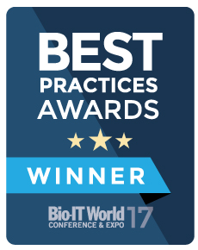
The Allotrope Framework 101
NSF MRSEC Facilities Satellite &
MRFN Workshop 2018

Slide 2
Why: Common Problems Across The Data Ecosystem
It’s hard to find data based on intuitive starting points
  across the industry as much as 30% of the analytical work is repeated because it’s easier than finding the original
It’s hard to share, compare, integrate data from different labs or instruments because the file format is different
  requires conversion/transcription introducing potential for error
It’s hard to mine a collection of data because the details & context of the experiment is stored somewhere else
Can’t understand /interpret data later because the context is incomplete, inconsistent, or free text
Instrument & software interoperability is limited…at best
  increases custom integration, constrains purchase options & utilization
Notes:
Transition to next slide: These are a few examples of issues that affect our entire analytical data lifecycle

Slide 3


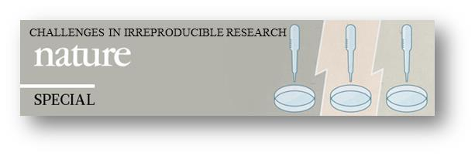
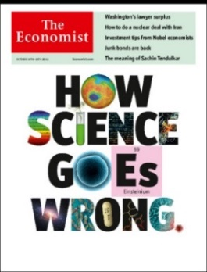
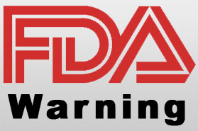
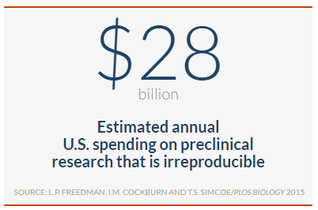
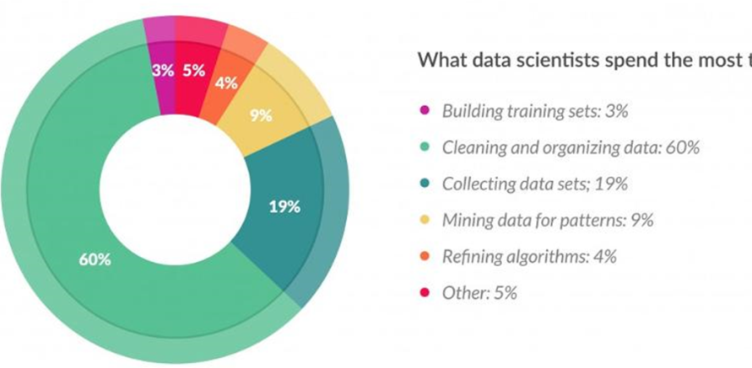

Status quo in the laboratory
Data capture, integration & sharing challenges
Some records still paper-based
Manual transcription of methods and data
Incompatible instruments, software and data formats
No controlled vocabulary
Data integrity and scientific reproducibility challenges
Knowledge & context only in people’s heads
Silos of data, context and meaning
Suboptimal knowledge management
Potential to delay getting medicines to patients & erosion of public confidence
What data scientists spend the most
time doing:

Slide 4
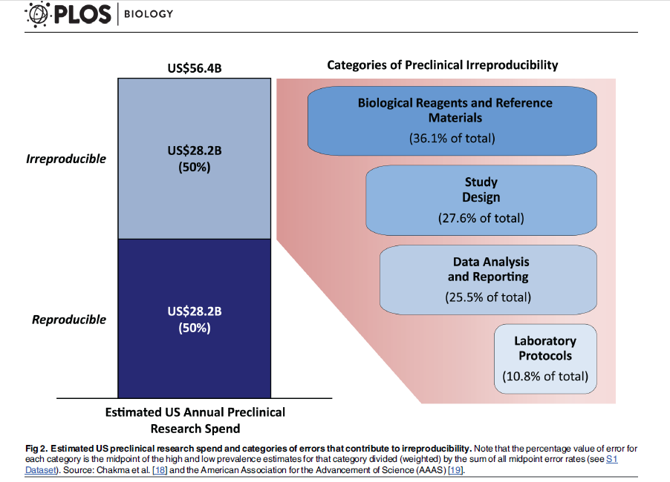
Reproducibility: Data Quality and Context Matter
Characterization
of starting
materials…
The context of
the experiment…
PLOS Biology | DOI:10.1371/journal.pbio.1002165 June 9, 2015

Slide 5
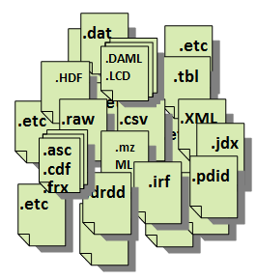
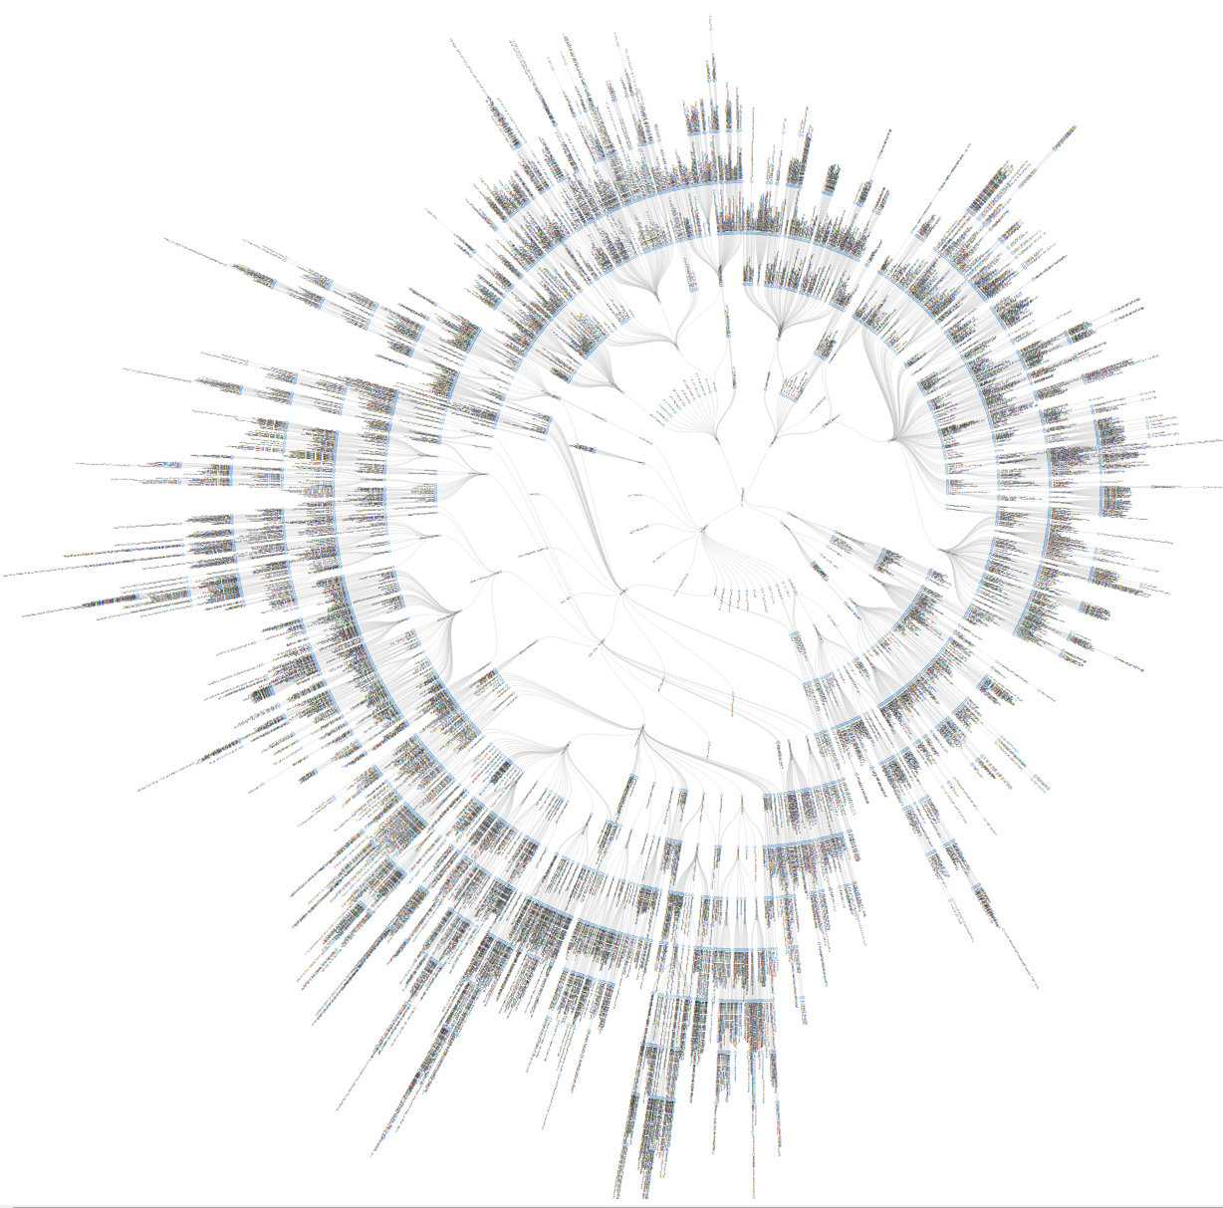


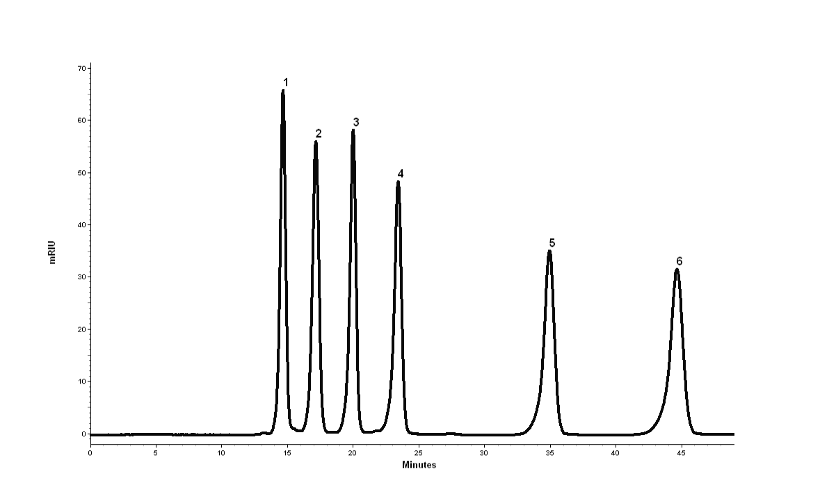







Rethinking Scientific Data
Vendor-Specific Formats
Data in Standard Format
Paper, unstructured text for methods, regs, recipes, results, etc...
A Standard vocabulary & metadata structure
Process
Material
Equipment
Result
fix the root cause of inefficiencies & data integrity challenges
Reduced Manual Effort & Paper
Streamlined Access, Sharing, Integration
Increased Data Integrity, Context, Quality
Lower Innovation Barrier
Better Scientific Reproducibility
Simplified IT
Foundation for Data Science
Notes:
Solving the issue we create with things we care about
Requires a new approach to our data and: (1) a new generation of software the will reliably and consistently record the science we do, and (b) the elimination of human factors from activities that computers do better
a community of people working together to use public standards and shared data models that are implemented by software using a shared

Slide 6

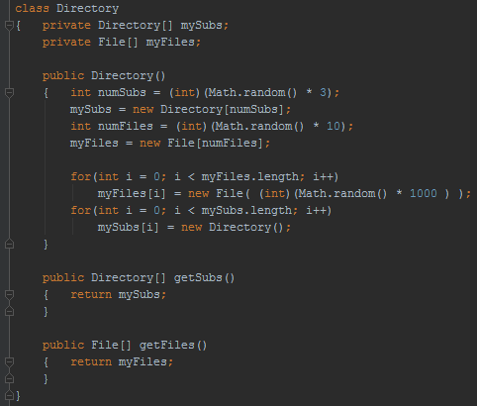


The Allotrope Framework
A standardised semantic model for data & metadata.
Released Dec 2017
Released July 2017
Ontologies
Allotrope Data Format
API
ADF Explorer
Data Description
Semantic Model
Data Cubes
Universal Data Container
Data Models
Data Package
Virtual file system
Coming Nov 2018
A high-performance binary data format.
Instrument, vendor, platform agnostic.
An API to allow consistent creation & reading of ADF files.
ADF Explorer allows browsing of existing ADF files.
A set of constraints on the semantic model using data shapes.
Notes:
The Allotrope Data Format is a vendor, platform, and technique agnostic format adaptable for any laboratory technique to store the data, contextual metadata, and any ancillary files; a self-contained experiment. Class libraries provide the reusable software components to adapt existing applications or create new solutions that work with the ADF and taxonomies, and ensure the consistent adoption of the standards. The ADF Explorer is a free, standalone, lightweight application provided for opening and viewing data stored in the data description, data cube, and data package within an ADF file.
Data Description: Descriptive metadata in a semantic model. Enables storage of method, instrument, sample, process, result, etc., plus Data Cube, Data Package indices, Provenance, audit trail, data models
Data Cube: raw acquired data, represented by one- or multidimensional arrays of homogeneous data structures.
Data Package: Data represented by other formats, incl. native instrument formats, standards for images, pdf, video, etc.
​
The Allotrope Taxonomies and Ontologies form the basis of a controlled vocabulary and relationships for the contextual metadata needed to describe and execute a test or measurement and later interpret the data. Drawing from thought across member companies and the Allotrope Partner Network the standard language for describing the equipment, processes, materials, and results is being developed to cover a broad range of techniques and instruments, driven by real use cases, in an extensible design. Defined independent of the data format to provide extensibility for supporting any technique or workflow.
​
Allotrope Data Models provide a mechanism to define data structures (schemas, templates) that describe how to use the ontologies for a given purpose in a standardized (i.e. reproducible, predictable, verifiable) way.

Slide 7
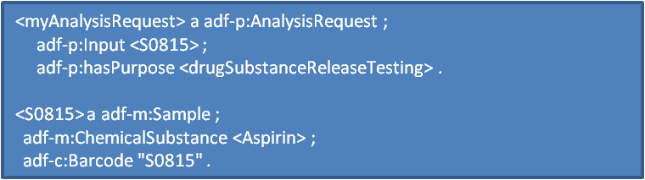
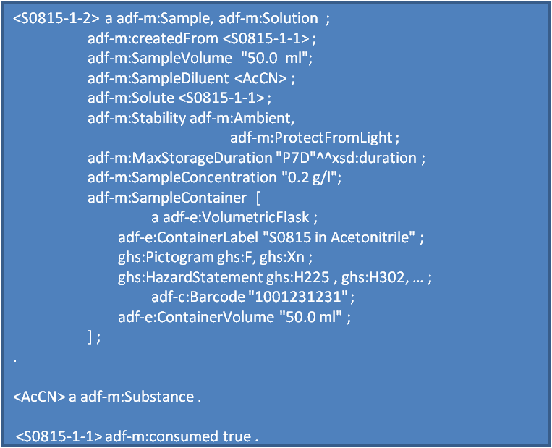
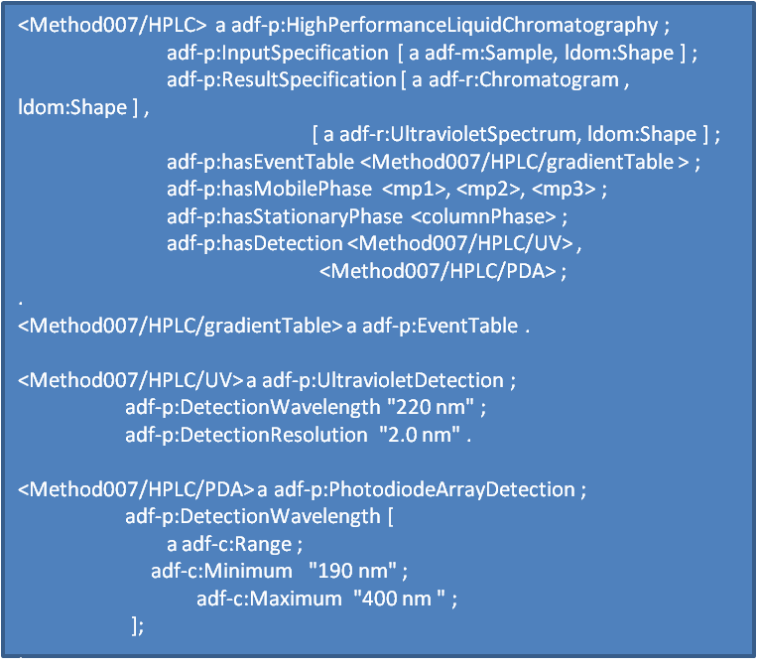
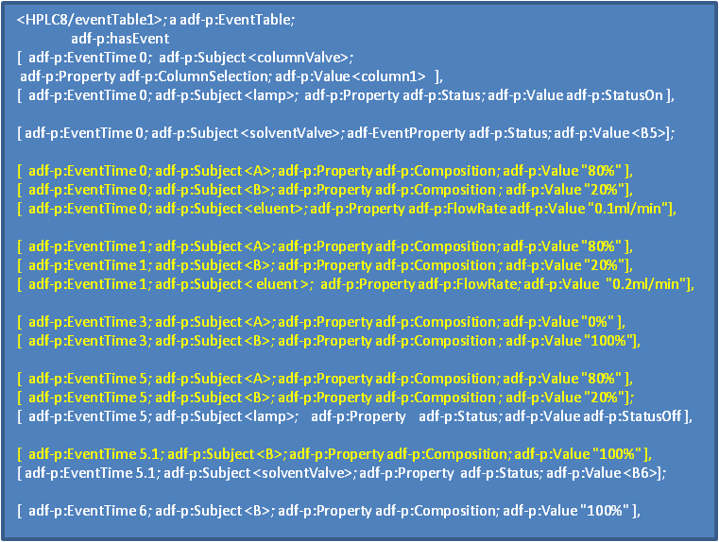
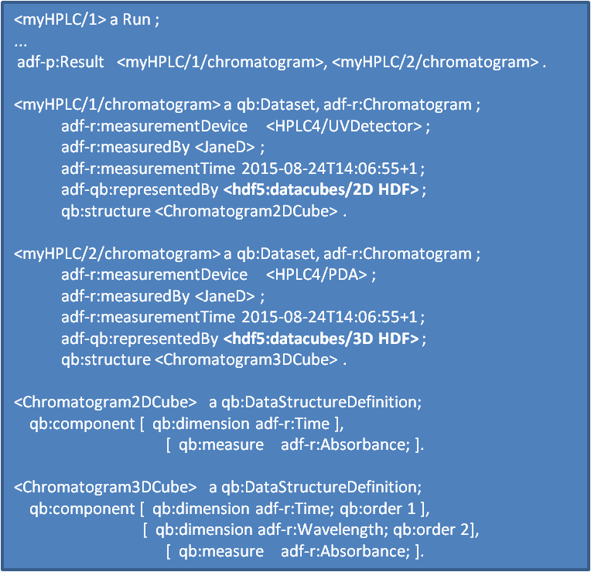
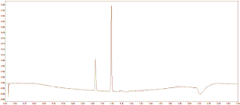




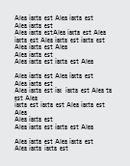
Allotrope Data Format Example
Platform Independent File Format
Data Description
Descriptive metadata about
Method, instrument, sample, process, result, etc.
Data Cube, Data Package contents
Provenance, audit trail, data models
Request
Sample
Method
Run
Data & Results
Data Cubes
Chromatogram: 2D
Chromatogram: 3D
Analytical data represented by one- or multidimensional arrays of homogeneous data structures.
Chromatogram 2D HDF
Chromatogram 2D HDF
Data Package
Data represented by arbitrary formats, incl. native instrument formats, images, pdf, video, etc.

Slide 8
Contextual meta data accumulates along every step…
Request ‘System’
File Shares, Databases
Request/Reason
LIMS
ELN
Instrument Software
Analysis Software
Report/Publish
Search & Reuse Data
Plan Analysis
Prepare Samples
Submit Samples
Control Inst. Acquire Data
Process Data
Analyze Data
Capture & Reports Results
Store, Archive, Mine
Analytical Method
Sample Prep Data
Instrument Instructions
Instrument Data
Processed Data
Analyzed Data
Reported Results
Stored Data
… distributed across multiple systems and records

Slide 9
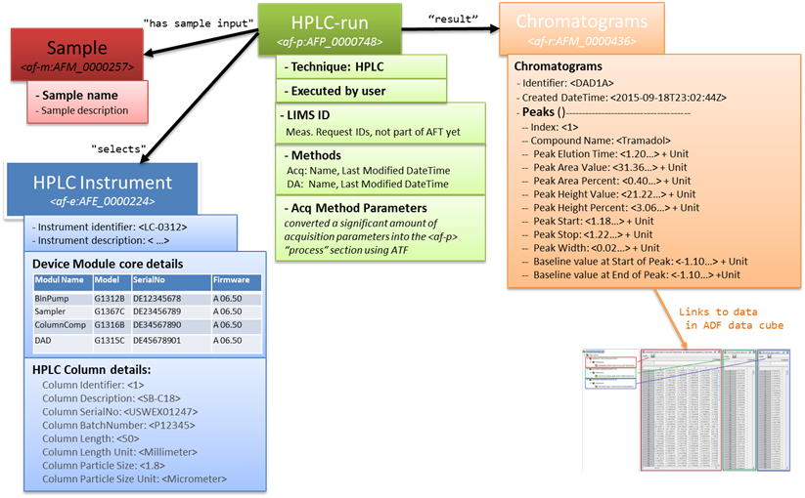
Example: ChemStation Metadata Content
9

Slide 10
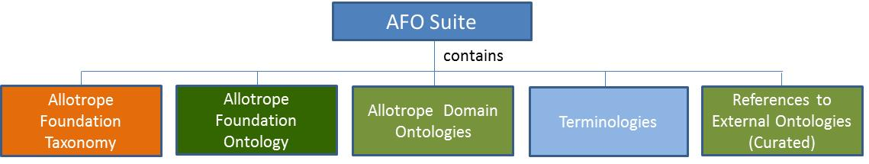
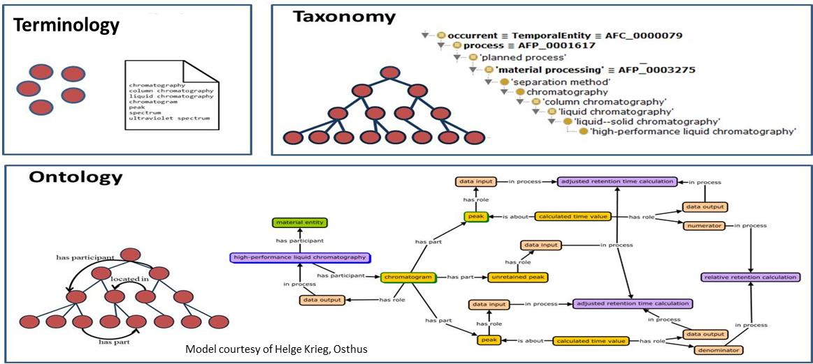

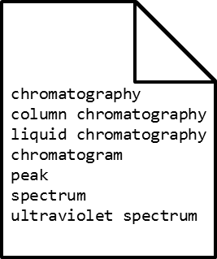
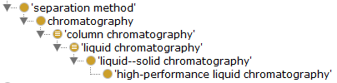
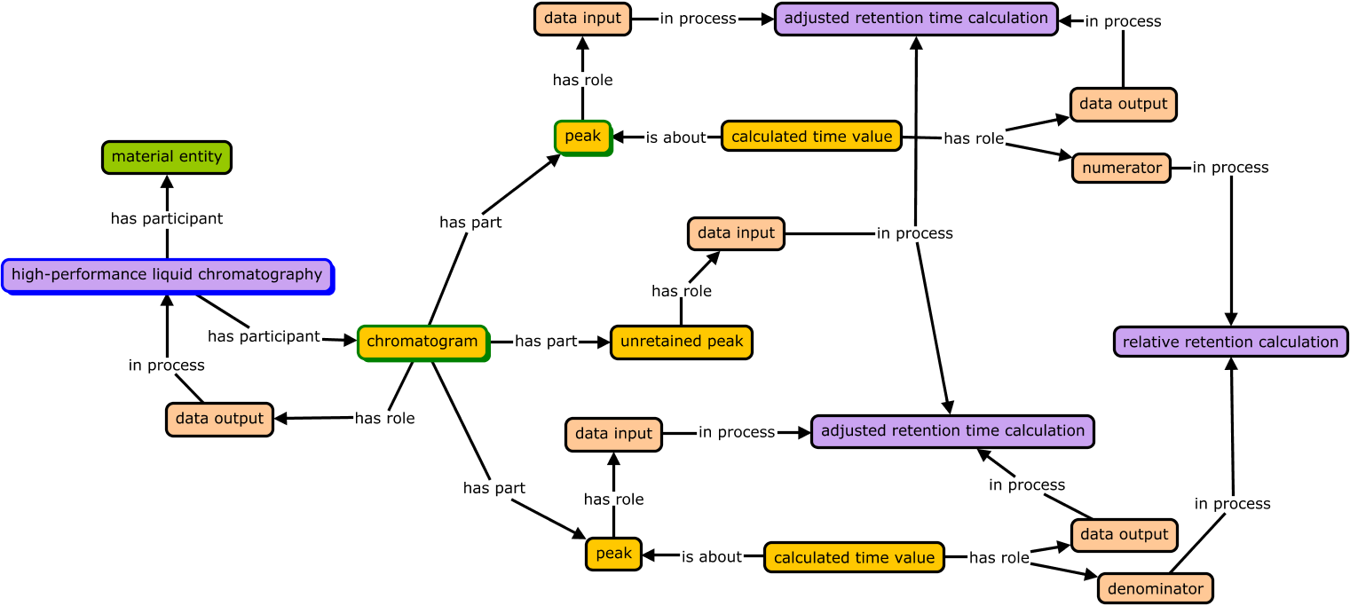
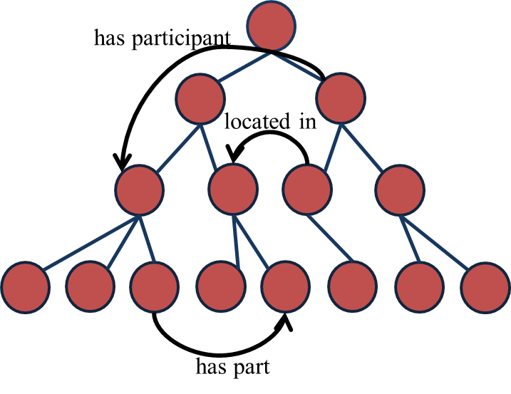
Ontologies
Model courtesy of Helge Krieg, OSTHUS

Slide 11
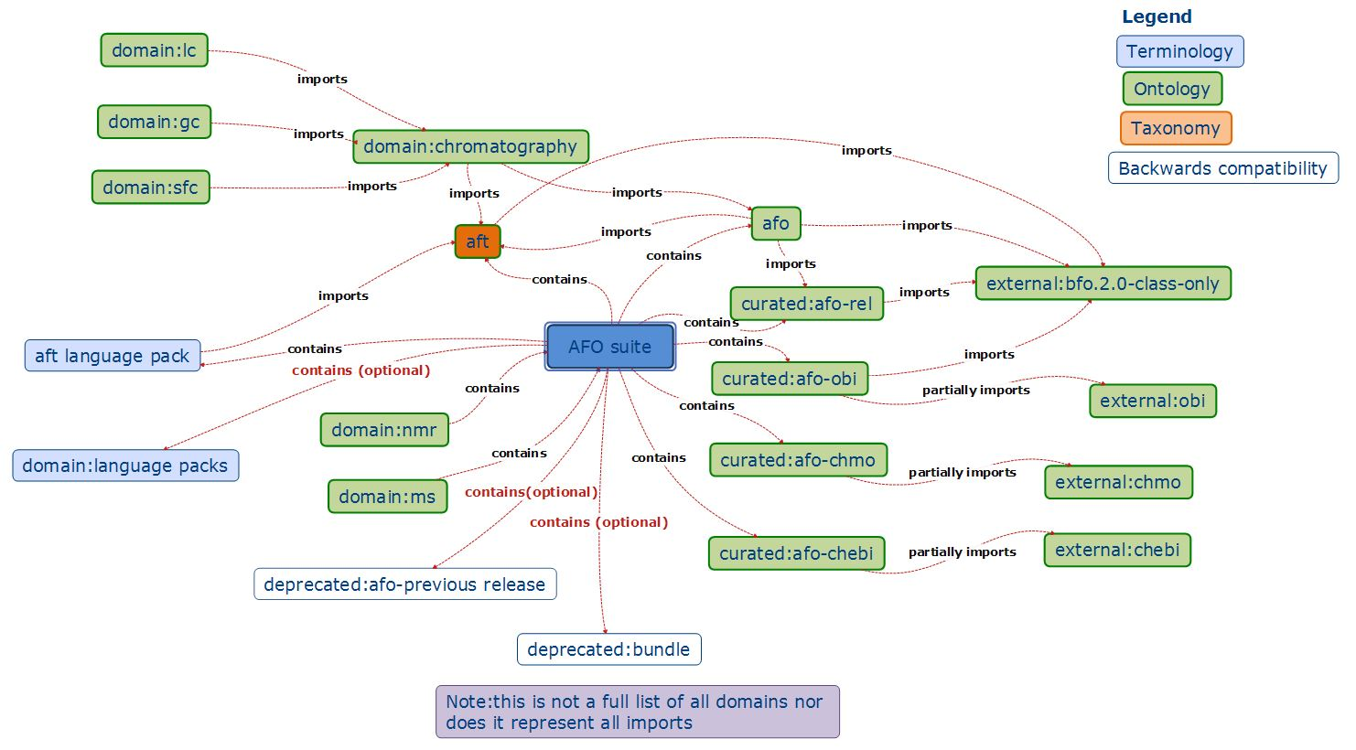
Allotrope Foundation Ontologies (AFO) Suite

Slide 12
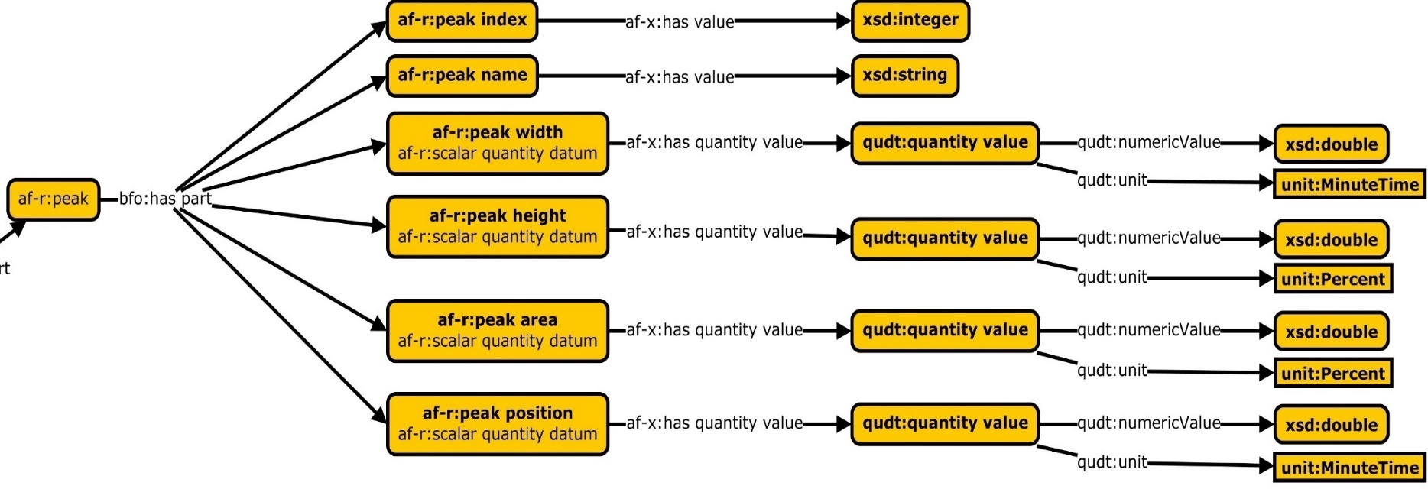
Data Models: Example- HPLC
  Ontologies provide an unconstrained vocabulary we can use to describe things (instances) in our open world and give them a meaning (= what it is)
  Data structures (schemas, templates) describe how to use the ontologies for a given purpose in a standardized (reproducible, predictable, verifiable) way
  Shapes Constraint Language (SHACL, expressed as RDF) is a WC3 standard to do this, used for Allotrope ‘Data Models’

Slide 13
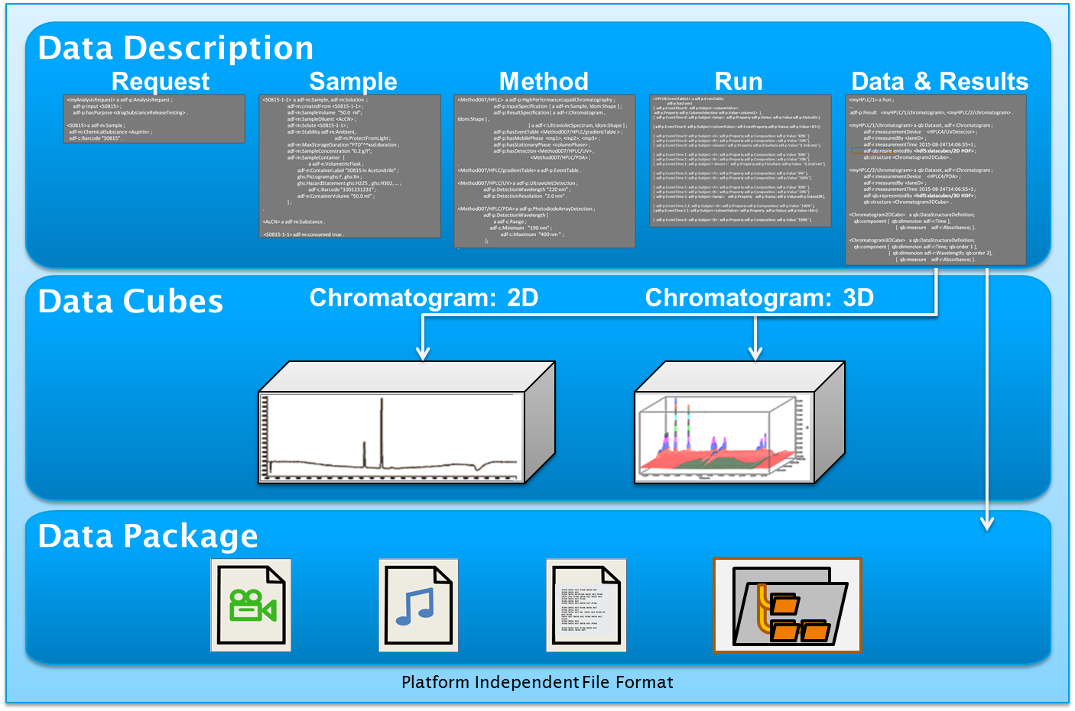
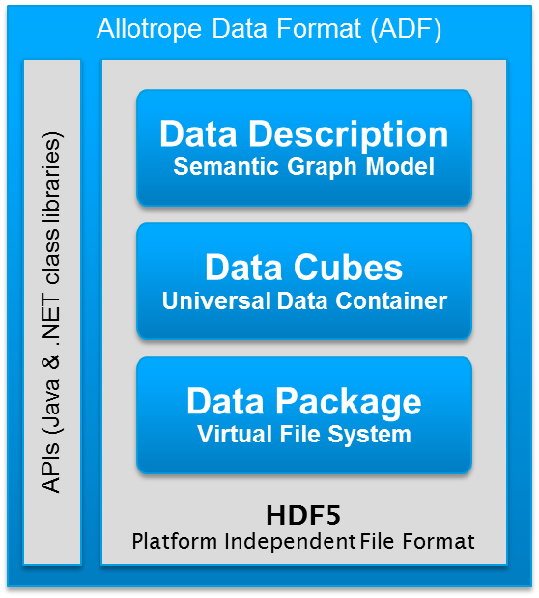
A Foundation for Interoperability
& Next Generation Analytics
Allotrope Foundation Ontologies (AFO)
Stability
Batch Release
Solubility
…
Allotrope Data Models (ADM)
HPLC
MS
NMR
…
Stability Study
Batch Rel. Study
Solubility Study
…
Taxonomies
HPLC-UV
Experiment
MS
Experiment
NMR
Experiment
…
Material
Equip-ment
Process
Result
Proper-ties
Request
Report
Search & Reuse Data
Plan Analysis
Prepare Samples
Submit Samples
Control Inst. Acquire Data
Process Data
Analyze Data
Capture & Reports Results
Store, Archive Mine
Analytical Method
Sample Prep Data
Instrument Instructions
Instrument Data
Processed Data
Analyzed Data
Reported Results
Stored Data

Slide 14
How do we reduce this to practice?
Standardized Data & Metadata
?
Ontologies
Allotrope Data Format
API
Data Description
Semantic Model
Data Cubes
Universal Data Container
Data Models
Data Package
Virtual file system

Slide 15
Standardized Data & Metadata
Build it in-house
Commercial Software & Services
Enabled
Software
Quick, near term value
You own it, control it
Cost of ownership
Adoption one company at a time
Longer dev lifecycle
Longer term value
Supported
Adoption across industry
Ontologies
Allotrope Data Format
API
Data Description
Semantic Model
Data Cubes
Universal Data Container
Data Models
Data Package
Virtual file system

Slide 16
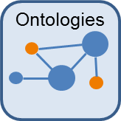
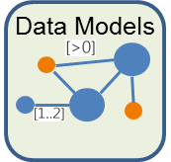
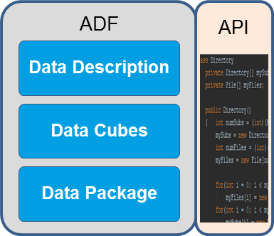
Integrating with the major informatics capabilities
Plan Analysis
Prepare Samples
Submit Samples
Control Inst. Acquire Data
Process Data
Analyze Data
Capture & Reports Results
Store, Archive, Mine Data
ELN
ELN/LIMS
LIMS
Sample Handling
Instrument Software
Analysis Software
Data Repositories
CDS/SDMS (HPLC)
Converters

Slide 17
Development & Implementation Paths
Allotrope Foundation Projects
  Core development, Allotrope managed, funded via Foundation operating budget;
Member company integration projects
  Funded by the company involved, self-managed
  Frequently a collaborative effort with vendor
  Framework or semantic extension contributed back to Allotrope
Allotrope Community Projects
  Defined & co-funded by participating subset of Member or APN companies
  Framework or semantic extensions contributed back to Allotrope
Collaborations with other consortia, initiatives (i.e. Pistoia Alliance)
  Method Database PoC, leveraging Allotrope Framework and standards

Slide 18
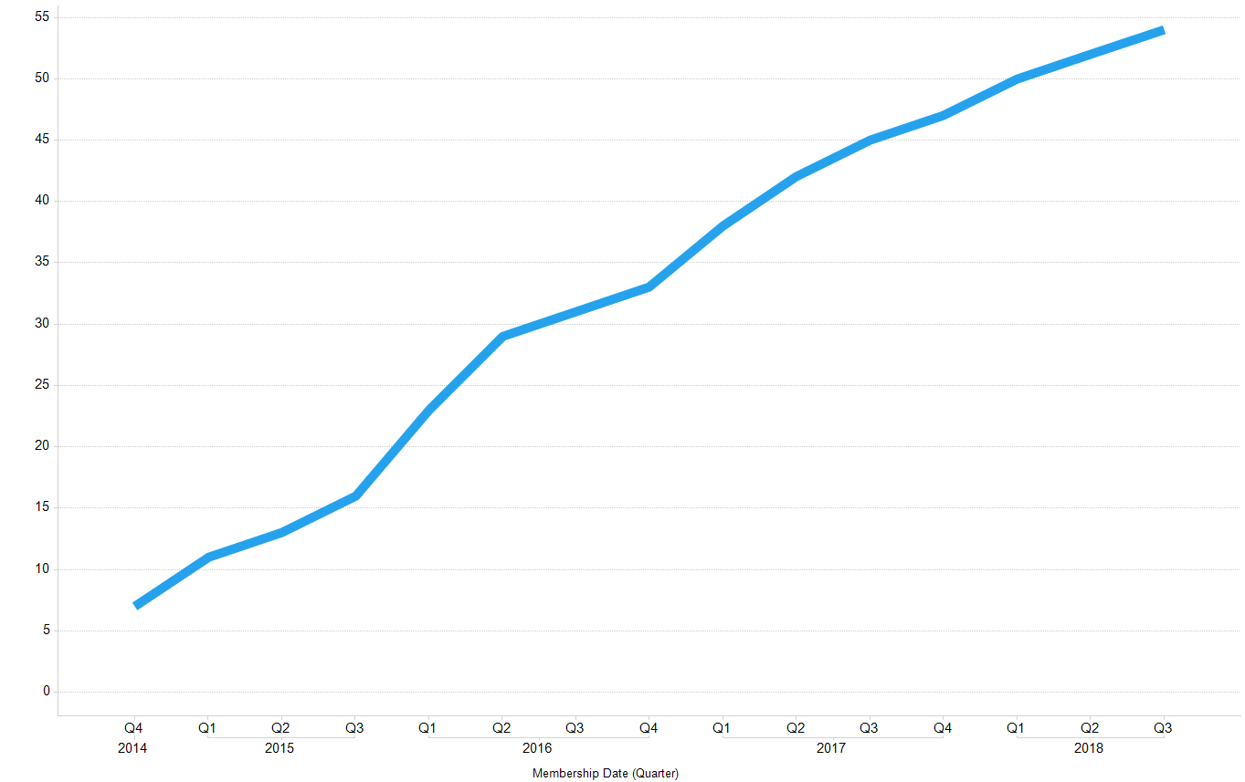
Allotrope Partner Network Growth
Mestrelab Research
Waters
Agilent
Shimadzu
University of Southhampton
Erasmus MC
Riffyn
Persistant
LEAP Technologies
Malvern
National Physical Laboratory (NPL)
Paris Dauphine University, Lamsade Laboratory
Pangaea Enterprises
L7 Informatics
CognitiveChem
Lablicate
Accenture
Science & Technology Facilities Council
University of Strathclyde, Glasgow
PerkinElmer
Bruker
TetraScience
Getty Institute
Fraunhofer IPA
Zifo RnD Solutions
Stanford University
Abbot Informatics
Rondaxe
Unchained Labs
Sciex
Synthace
HDF Group
ACD/Labs
BSSN Software
Idbs
Mettler Toledo
Sartorious
ThermoFisher
Biovia
ZONTAL
Cognizant
Halo Digital
Paradigm4
Elemental Machines
Astrix Technology Group
HCL
National Institute of Standards & Technology (NIST)
DEXSTR
GE Healthcare

Slide 19
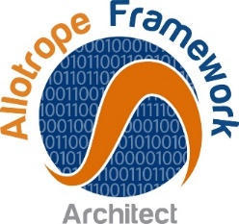









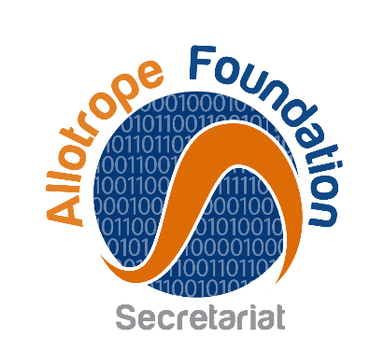



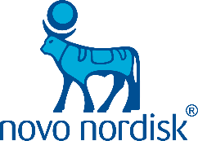

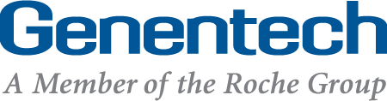

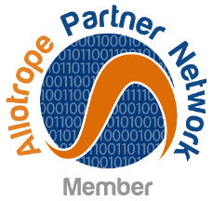
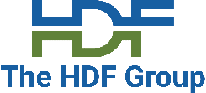







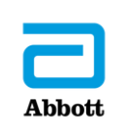
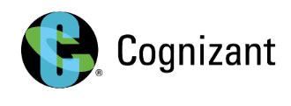

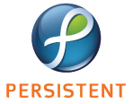

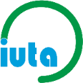


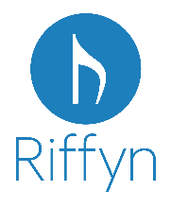






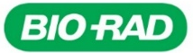
















The Allotrope Community Today
Brigham Young University • BSSN Software • Elemental Machines • Erasmus MC • Fraunhofer IPA • L7 Informatics
Mettler Toledo • NIST • SciBite • Stanford University • University of Illinois at Chicago • University of Southampton

Slide 20
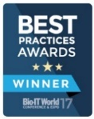
Allotrope Framework:
From concept to reality
Phase III: Grow & Sustain Ecosystem
ADF/API enhancements & testing
V1.1 released internally (Mar)
Increased vendor contribution
Release roadmap
V1.2 released internally (Nov)
Evolve the model to meet new challenges
2022+
2018
Learn by doing
Phase II: Commercial
Development
2017
Collaborate; find people that know what you don’t
Don’t invent the wheel, re-use
2016
ADM Data Model Release
Commercialization
Feasibility studies & POCs
Design, testing & due diligence
Initiate software development
Evaluation of existing standards
2015
BioIT World Best Practice Award
ADF/api Release Q2
AFO Ontology Release Q4
Embedded in member companies; in production @ 2
Allotrope Launched
Scope & strategy defined
2014
API & Taxonomy development
V1.0 released internally (Sept)
1st deployments @ member companies
2013
2012
Release iteratively
Phase I: Proof of
Concept Studies
Engage experts across all sides of the technology market

Slide 21







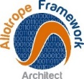
Taxonomy, Ontology and Data Model Governance
Vendor A
SMEs
Vendor B
Working Groups
Curation
Team
Public Review
Integration
Release
Vendor C
Pharma 2
Academia
Knowledge
Engineer
Principal
Semantic Architect
Pharma 1
Working groups collaborate independently to create taxonomies & models for instrument techniques or workflows, which are then integrated with the whole

Slide 22
Allotrope Developer Community and Governance
Open Source Exchange
Developers share their code with others (public or internal)
No structured governance (some guidelines may apply)
Community Projects
Multiple companies collaborate on a shared development
Governed by the project leader (some guidelines may apply)
Incubator
Contributions accepted by the Foundation
Released Allotrope products
Product
Alignment of contributions with the Allotrope Standards
Governed by the Foundation
https://gitlab.com/allotrope-open-source
https://gitlab.com/allotrope-community
https://gitlab.com/allotrope-incubator
https://gitlab.com/allotrope
Maintenance and sustainment
Governed by the Foundation

Slide 23
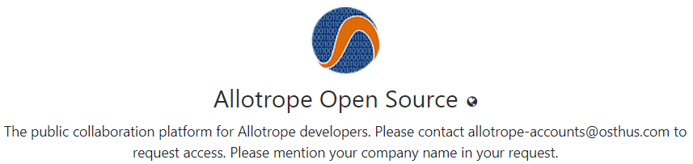
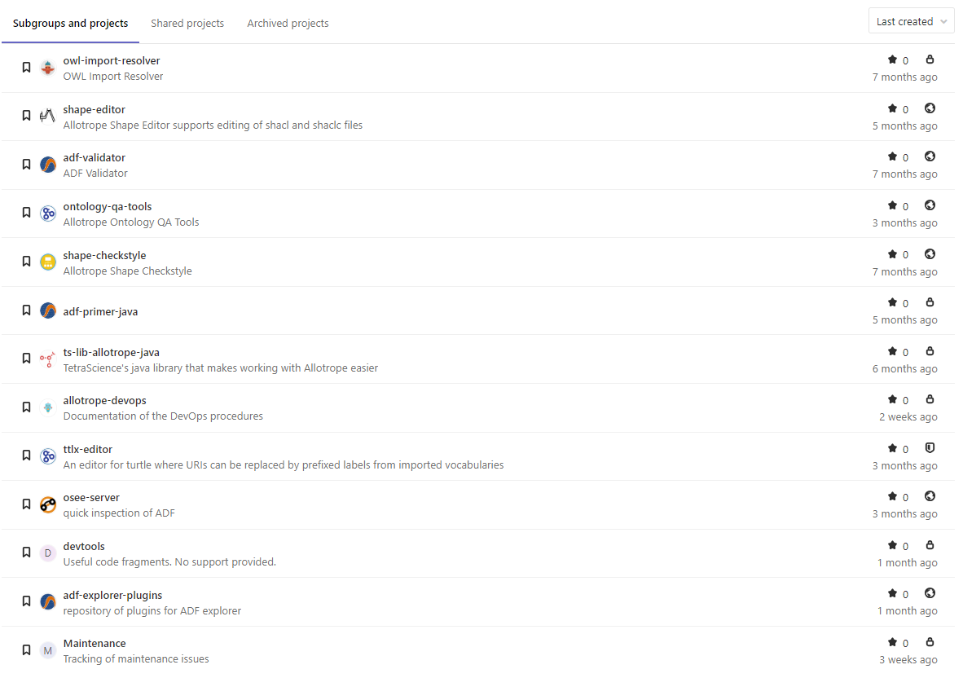

Slide 24
Sample implementations across the community
Project Title | Summary Deliverables | Analytical Method | ADF | AFO | ADM
Measurement Taxonomy & Materials Taxonomy Development | develop a measurement and material taxonomy | no specific technique | ○ | ● | ○
Analytical Method Exchange & Archive | Exchange HPLC-UV/MS methods between LIMS and Instrument via ADF format | LC/MS | ● | ● | ●
Dataconverter -> NMR | offline data converter from NMR to ADF ; development NMR taxonomy | NMR | ● | ● | ●
Automated Equipment Management | self-identifying and -registering system for HPLC equipment | LC/UV | ○ | ● | ●
Chiral Methods Screening Workflow | data retrieval in converter ADF & consider analytics and QSAR predictions of chiral perform | LC/UV; LC/MS (SQD only) | ● | ● | ●
Scientific Data Archive (SDA) Strategy | usage of ADF as part of the Big Data platform | LC/UV; LC/MS; pH; Protein Conc.; Process Streams | ● | ● | ●
Ana2 Instrument Data Storage and Automation System | archiving platform; MS to ADF converter | LC/MS; not addressing a specific technology | ○ | ● | ●
Biologics Charaterization | Peptide Mapping by MS | LC/MS | ● | ● | ○
Framework enabled holistic lab for process development | ADF data packets for instruments; AFT/AFO as ELN master data | all | ● | ● | ●
Converting high-throughput solubility into ADF | Ontology, ADF-converter, Excel-Add-in gto convert native format to ADF | LC/UV; pH | ● | ● | ○
Converting Bioanalysis and Metabolomics studies to ADF to enable data mining | Converter for native MS to ADF | LC/MS | ● | ● | ○
GE ÄKTA integration in to ELN data lake | OPC (UA) connector to cloud-based ADF converter | prepLC | ● | ● | ○
ADF data management & integration to ELN | data converter, search & ELN integration | LC/MS; | ● | ● | ○
simple device integration to ELN | RESTful ADF-conversion service | Bioanalyzer | ● | ● | ○
AFO as ELN master data | taxonomy extensions | LC/MS; prepLC; LC/UV; BGA; CellCounter… | ○ | ● | ○
data extraction from ADF into ELN | ADF to Word converter for ELN import | LC/MS; LC/UV | ● | ● | ○
format conversion to enable 3rd party spectral database | ADF input, search & data mining | LC/MS | ● | ● | ○
data visualization of ADF | integration layer for ADF visulization tool | LC/UV | ● | ● | ○

Slide 25


By Rethinking Scientific Data Enables
Smart Labs for the 21st Century
Smart labs will provide the research enterprise with:
Integrated Data – common reference data structures (vocabularies)
Sharable Data – easier interaction across teams, partners, business units
Scalability – Big data applications that can be highly elastic
Conceptual Representations – context and perspective are captured
Advanced Analytics – complex & automated problem-solving capabilities

Slide 26
Thank you!
For questions, please contact the Secretariat at more.info@allotrope.org or
james.vergis@dbr.com, dana.vanderwall@bms.com
Fall 2018 Workshops
  November 6: Cambridge, MA @Biogen
  http://www.allotrope.org

Slide 28
The core principles
Collaborate
Find people that know what you don’t
Don’t invent the wheel, re-use
Learn by doing
Engage experts across all sides of the technology market
Release iteratively
Evolve the model to meet new challenges

Slide 29
LC-UV- Extended data model
Delivering the 3rd Framework product- ADM for LC-UV
Instrument | Use Cases | SME Input | Model built | SME/Public Review | Allotrope Governance | Artifacts Complete | Notes
LC-UV | Analytical chemist can retrieve LC-UV method parameters, instrument description, and results from ADF for use in data mining, method development, results reporting, and control charting. CDS developers able to store information to help achieve the above goals of analytical chemist | YES: LC-UV working group | YES: dedicated to LC-UV ADM team | Model in public Review as of: 20-Sept-2018 | Preliminary semantic governance provided. Final Governance in Nov/Dec 2018. | See Gitlab project LINK CMAPs, TTL files, instance data, example ADF, SHACL, AFO | Currently excludes calibration data, conformance with specifications, and multiple applications

Slide 30
Chromatography WG
Extending ontology & model development based on LC-UV
Liquid Chromatography
  Provided key SME input to develop graph LC-UV model now in public review
  CMAPs based on AFT1.1.5 – calibration curves and auto sampler rinsing
  CAD detector - SME screen shots; operating parameters identified
  A/D conversion - SME screen shots, ttl based on v 1.1.5
  Gas Chromatography
  TCD and FID – CMAPs based on AFO 2.1.2 created (Dave)
  ECD and Injectors (Split/Splitless, Packed, and On-column) - SME screen shots and operating parameters identified (Dave)
  A/D conversion - SME screen shots (Dave)
  LC-MS (SQD)
  AFT 1.1.5 SME screen shots; operating parameters identified, v 1.1.5 ttl file (Heiko – Data Cube, place on Ontology WG Agenda)
Columns
  completely modeled on AFO 2.1.2 (Wes /Heiko )

Slide 31
ADM Instrument Models: Oct 1, 2018- Simplified design
Building on approaches & tools for LC-UV model, extending to new techniques, demonstrating reusability & scalability
Instrument | Use Cases | SME Input | Model built | SME/Public Review | Allotrope Governance | Artifacts Complete | Notes
Cell Counter | N/A | ✓ | ✓ | ✓ | ✓ | ✓
Blood Gas Analyzer | N/A | ✓ | ✓ | ✓ | ✓ | ✓
pH meter | N/A | ✓ | ✓ | In process
Conductivity Meter | N/A | ✓ | ✓ | In process
Osmolality Meter | N/A | ✓ | ✓ | In process
RAMAN | Raw data and identification | ✓ | ✓ | ✓ |  |  | Raw data and identification use case only
NMR | Full capture of all data | ✓ | ✓ |  |  |  | BI/Pfizer/Bruker only, data descriptor only
Balance | N/A | ✓ |  |  |  |  | Challenges with precision model desired by SMEs

Slide 32
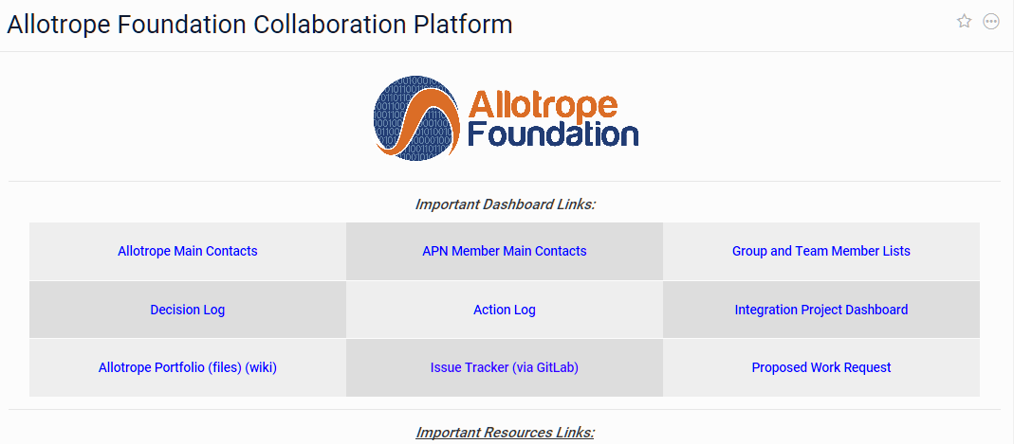
Allotrope Project Dashboard
Simple interface for Allotrope & APN Members
Single location to capture and display all projects increase transparency, improve connectivity and trigger ideation
Minimal effort to capture critical information,
Capability to store additional detail documents
See Link

Slide 33
New collaboration models in 2018
Allotrope Community Projects
  Objectives
    Increase adoption
    Accelerate development
    Improve collaboration between members and vendors
  Defined & co-funded by participating Member or APN companies
  Any resulting Framework enhancements or extensions contributed back to Allotrope
  First example in-flight: Empower Data Converter
Collaboration with Pistoia Alliance
  Method Database PoC in-flight, leveraging Allotrope Framework and standards

Slide 34

Pitstoia-Allotrope Method DB: Digitalizing the “Analytical Method Description” will improve Data Reproducibility and reduce Method Implementation effort
Introduction
2018 PoC Deliverables
Method recapitulation is difficult and time consuming, within a company and even more across collaborating partners.
A solution to store, search and retrieve a digital version of a method would improve scientist’s ability to retain institutional knowledge, reduce time for method development and improve the process for method execution.
Replacing the text-based Method instructions with a digital, standardized instruction will lead to better experimental reproducibility
A framework only handling HPLC data with two CDS systems and few different instruments.
Key 5 components are:
Method Model for LC UV Data Acquisition
  Definition of common parameters
  Method model
Method Database
  Method file import and export
  Method file search and visualization
Human Readable Method PoC
  Text version of digital instruction set
Import/ Export capability for Agilent CDS
Import/ Export capability for Empower CDS
Sponsors/Partners

Slide 35


Slide 36
The Benefits
Patients
Safer Medicines
Sooner
Lower Cost
Pharma
Better Scientific Reproducibility
Increased Data Integrity, Context, Quality
Consolidated Requirements
Lower Innovation Barrier
Reduced Manual Effort & Paper
Streamlined Access, Sharing, Integration
Simplified IT
Foundation for Data Science
Standardized Data & Metadata
Notes:
1- By eliminating manual data translation, copy/paste activities, and enabling someone to find data in seconds, we remove significant manual effort from the workflow, which speeds up delivery of medicines to patients or products to market, and allows that effort to be focused on more important or innovative work.
2- The semantic capabilities of the Allotrope Framework enable a complete and unambiguous description of the experimental methodologies, conditions and processes leveraging a controlled vocabulary provided by the Allotrope Ontologies and data models. By leveraging the Allotrope ontologies and data models in the
software used to plan and execute an experiment and analyze the results, the context of the data and results can be captured completely and unambiguously. In a fully integrated implementation, the experimental method can be reused directly as an explicit set of instructions to repeat the measurement or experiment- a paradigm shift from free text entry via keyboard and personal decisions as to the relevant details, to the means to capture, transfer and repeat a process via standardized output that a computer can execute reproducibility. This means others will know exactly what was done and will be able to reproduce the original work with a few clicks. Think about how much more efficient and effective collaboration with external partners would be if sharing methods and results was seamless and unambiguously clear.
3- Address data integrity at the source by eliminating the need to convert between file formats or manually retype data, and prevent errors before they can occur. The adoption of the Allotrope Framework significantly improves data integrity by providing a single, common data format for any analytical technique, the controlled vocabulary, as well as the software components to adapt existing software applications or create new solutions that work with the ADF, and ensure the consistent adoption across our informatics environment.
4- One language and one format for data greatly simplifies integration between applications and provides the kind of interoperability realized in other technologies through formats like the MP3 file or standards like Bluetooth and those the Internet Engineering Task Force (IETF) use to make the Internet work. With adoption of the Allotrope Framework by the vendor community, the companies generating and consuming data will see a decreased cost of integrating new software and instruments, as well as significantly lower effort and expense for support and maintenance due to the reduction of custom integrations and work-arounds. Besides reducing the effort and cost of integration, an informatics architecture based on the Framework opens the door to a much higher level of system and process automation and efficiency gains that yield improvements in speed and/or capacity.
5- By capturing data and the contextual metadata in the ADF - using the Allotrope Ontologies for the metadata, the indexing of data repositories, archiving systems and data lakes will provide a much richer and harmonized index, making it possible to find data in seconds. The adoption of the ADF and elimination of all the diverse file formats currently used means that data from any instrument, group, department or partner can be read or integrated seamlessly. This significantly reduces the friction and overhead of external partnerships, and improves the quality and detail of the data sharing, replacing the documents and PDFs in typical in today’s environment.
6- The architecture of the data description layer of the ADF is based on semantic web and linked data concepts using an RDF Data Model, a World Wide Web (W3C) consortium standard. This provides the capability to build in business rules and other analytics on top of the standardized vocabularies, giving companies enhanced abilities to classify and manage their data. Legacy systems can be maintained more easily and new technologies including cloud databases, Big Data Analytics, or reasoning engines can be employed to allow researchers unprecedented access to important contextualized data, because the foundational class structure is common and highly extensible to new and expanding domains.
7- The Allotrope standards and APIs represent a consolidated set of requirements. So, as a vendor of instruments and/or software, or provider of professional services, supporting customers who want to adopt the standards implemented by the Allotrope Framework means a reduction in the complexity and diversity of customer requirements both now and in the future.
​
Legacy data formats can create dependencies on software that would otherwise be obsolete. This adds cost and increases friction to introducing innovation if it requires an updated or new file format to capture additional or new types of data. A consolidated set of standards flexible enough to accommodate more dimensionality, detail or complexity to the data, while still supporting legacy data, removes that cost and reduces the friction of introducing new innovations to a mature market.
The reduction in non-value added time and labor in the data lifecycle, via standardization, coupled with the opportunities the semantic foundation offers, will open the door to a whole new world of need and opportunity for innovation and new solutions in the data lifecycle- which means opportunities for new products, new verticals, new partnerships.

Slide 37
2018
Framework
Complete v1 Data Model (ADM)
Operationalize ontology & model development
Drive adoption
Community Projects- drive adoption & demonstrate value
Organization
Create focus on support for commercial entities & developer community
2018

Slide 38




Agilent Technologies Inc. CEO Michael McMullen on Q3 2018 Results - Earnings Call Transcript

Slide 39



Before Today
After Today
Simplification
Scalability
Commercial Vendor Products
New Innovation Opportunities
Membership Growth
Cross-Initiative Collaborations
April 25, 2018

Slide 41








High Variety of Result Data
pH
thermogravimetry
chromatography
mass spectroscopy
HPLC-MS
HPLC-MS-MS
…
NMR
cell counter
Notes:
NMR: nuclear magnetic repulsion spectrometry
We tackle the Variability Problem of BigData.

Slide 42
Landscape of Existing Standards
NISO
LC
ISO
OAI
W3C
OASIS
IE TF
OMG
CDISC
Notes:
OAI: Open Archive Initiative
LC: Library of Congress
Evaluated: MZML, AniML, BatchML, ISA S88, …

Slide 43
Scope
Holistic solution for industry
Measurement process
offline, online, PAT
Research through Manufacturing process
chemistry, formulation, bioprocessing
Records management
record retention, regulatory submissions, reporting
Requirements from range of perspectives & roles
Regulators, bench scientist, data analysts, modelers, manufacturing, archivists, IT
Notes:
Second important concept in ADF design is the dimension of the process in which analytical measurements are used
Drivers of adoption

Slide 44
Key Requirements
Technical capabilities
Large data volume, small file size, fast
Platform independent
Comprehensive Metadata
Who, what, when, where, why and how
Long term data access
Documented file format
Vendor neutral format
Adaptable and extensible
Arbitrary techniques; extensible
Scientist, sample, time stamp/audit trail, instrument, purpose, method

Slide 45

ADF MS Example

Slide 46


Data Package Example
Page | 46

Slide 47
ADF Class Library
Data Package API
Data Cube API
Data Description API
(Apache Jena)
Triple Store API
Ontologies
  Platform independent file format
  (HDF 5)
  Class Library
Specifications

Slide 48

HDF 5 file format
HDF 5
http://www.hdfgroup.org/users.html

Slide 49

ADF Data Cube Ontology
http://www.w3.org/TR/vocab-data-cube/

Slide 50

Extension to the W3C Data Cube Ontology:
ADF Data Slabs
qb:Data Slice
adf:Data Slab
Data Slabs support sparse data

Slide 51

Triple Store Storage Concept
ADF Triple Store
SPO Index
POS Index
OPS Index
B+ Tree
B+ Tree
B+ Tree
Triple Table
Dictionary
B+ Tree

Slide 52
Allotrope Foundation Taxonomy Growth
Version 1.0
New Techniques 4Q2015
Other Taxonomies in 2016
gas chromatography
Karl Fischer
liquid chromatography
mass spectrometry
nuclear magnetic resonance spectroscopy
thermogravimetric analysis
ultra violet spectroscopy
capillary electrophoresis
cell counter
cell culture analyzer
blood gas analysis
balance
pH
Protein Characterization
Microplate Reader
Flow Cytometer
Protein Purification
Millipore Filtration System
Differential Scanning Calorimetry (DSC)
X-Ray Power Diffraction (XRPD)
Particle Sizer
Roller Press
Tablet Pressing
Tablet Coating
Dynamic Vapor Sorption (DVS)
solid-state NMR (ssNMR)
Extend Process
Extend Materials
Extend Equipment
Investigation/Study/Analysis
Phase of Development
Route of Administration
Product Quality Attributes
Container Categories
IDMP-Identification of Medicinal Products
Chemical Reactions
Maturity varies based use cases applied to-date

Slide 53
Documentation
Specifications
Reference Documentation
Primer, Developer‘s Guide
Case Studies
Example Applications

Slide 54

Specifications

Slide 55


Reference Documentation

Slide 56


Developer‘s Guide

Slide 57







Better Scientific Reproducibility
Increase Data Integrity, Context, Quality
Reduce Manual Effort & Paper
Streamlined Access, Sharing, Integration
Consolidate Requirements
Lower Innovation Barrier
Simplified IT
Foundation for Data Science
Notes:
1- By eliminating manual data translation, copy/paste activities, and enabling someone to find data in seconds, we remove significant manual effort from the workflow, which speeds up delivery of medicines to patients or products to market, and allows that effort to be focused on more important or innovative work.
2- The semantic capabilities of the Allotrope Framework enable a complete and unambiguous description of the experimental methodologies, conditions and processes leveraging a controlled vocabulary provided by the Allotrope Ontologies and data models. By leveraging the Allotrope ontologies and data models in the
software used to plan and execute an experiment and analyze the results, the context of the data and results can be captured completely and unambiguously. In a fully integrated implementation, the experimental method can be reused directly as an explicit set of instructions to repeat the measurement or experiment- a paradigm shift from free text entry via keyboard and personal decisions as to the relevant details, to the means to capture, transfer and repeat a process via standardized output that a computer can execute reproducibility. This means others will know exactly what was done and will be able to reproduce the original work with a few clicks. Think about how much more efficient and effective collaboration with external partners would be if sharing methods and results was seamless and unambiguously clear.
3- Address data integrity at the source by eliminating the need to convert between file formats or manually retype data, and prevent errors before they can occur. The adoption of the Allotrope Framework significantly improves data integrity by providing a single, common data format for any analytical technique, the controlled vocabulary, as well as the software components to adapt existing software applications or create new solutions that work with the ADF, and ensure the consistent adoption across our informatics environment.
4- One language and one format for data greatly simplifies integration between applications and provides the kind of interoperability realized in other technologies through formats like the MP3 file or standards like Bluetooth and those the Internet Engineering Task Force (IETF) use to make the Internet work. With adoption of the Allotrope Framework by the vendor community, the companies generating and consuming data will see a decreased cost of integrating new software and instruments, as well as significantly lower effort and expense for support and maintenance due to the reduction of custom integrations and work-arounds. Besides reducing the effort and cost of integration, an informatics architecture based on the Framework opens the door to a much higher level of system and process automation and efficiency gains that yield improvements in speed and/or capacity.
5- By capturing data and the contextual metadata in the ADF - using the Allotrope Ontologies for the metadata, the indexing of data repositories, archiving systems and data lakes will provide a much richer and harmonized index, making it possible to find data in seconds. The adoption of the ADF and elimination of all the diverse file formats currently used means that data from any instrument, group, department or partner can be read or integrated seamlessly. This significantly reduces the friction and overhead of external partnerships, and improves the quality and detail of the data sharing, replacing the documents and PDFs in typical in today’s environment.
6- The architecture of the data description layer of the ADF is based on semantic web and linked data concepts using an RDF Data Model, a World Wide Web (W3C) consortium standard. This provides the capability to build in business rules and other analytics on top of the standardized vocabularies, giving companies enhanced abilities to classify and manage their data. Legacy systems can be maintained more easily and new technologies including cloud databases, Big Data Analytics, or reasoning engines can be employed to allow researchers unprecedented access to important contextualized data, because the foundational class structure is common and highly extensible to new and expanding domains.
7- The Allotrope standards and APIs represent a consolidated set of requirements. So, as a vendor of instruments and/or software, or provider of professional services, supporting customers who want to adopt the standards implemented by the Allotrope Framework means a reduction in the complexity and diversity of customer requirements both now and in the future.
​
Legacy data formats can create dependencies on software that would otherwise be obsolete. This adds cost and increases friction to introducing innovation if it requires an updated or new file format to capture additional or new types of data. A consolidated set of standards flexible enough to accommodate more dimensionality, detail or complexity to the data, while still supporting legacy data, removes that cost and reduces the friction of introducing new innovations to a mature market.
The reduction in non-value added time and labor in the data lifecycle, via standardization, coupled with the opportunities the semantic foundation offers, will open the door to a whole new world of need and opportunity for innovation and new solutions in the data lifecycle- which means opportunities for new products, new verticals, new partnerships.

Slide 58






Join Allotrope Foundation!
Influence direction of development
Receive support & training
Be part of an expanding community of experts
Align internal strategy with the future of data
Ensure sustainability & adoption
Benefit from shared Investment
Notes:
1- As a member of the Foundation or Partner Network you have the opportunity to influence the direction and priorities of development efforts, and ensure the Framework meets the needs of your company or institution. It also provides the opportunity to align the strategic priorities and the roadmap for the next scientific domain in which to apply the Allotrope Framework in your science or business.
2- As a member of the Foundation or Partner Network you have the opportunity to influence the direction and priorities of development efforts, and ensure the Framework meets the needs of your company or institution. It also provides the opportunity to align the strategic priorities and the roadmap for the next scientific domain in which to apply the Allotrope Framework in your science or business.
This new paradigm will require competency in a new set technologies and approaches to our informatics architectures, and like any new technology speed to adoption and realizing its benefits confers an advantage. Allotrope Foundation comprises a broad and deep community of thought leaders in analytical sciences, IT, Quality, etc across 40 member companies and partners, representing academic, commercial and industry perspectives. As part of this community you can benefit from the shared knowledge developed and accelerate your adoption to realize the benefits sooner.
3- While the specifications of the ADF standard will be open and publically available, membership provides access to training materials and technical support to ensure your architects and developers are fully enabled to develop and integrate solutions implementing the Allotrope Framework.
4- Allotrope Foundation was launched because no one could afford to do this alone, so we’re sharing the investment to build the Framework. In the course of deploying solutions in-house that leverage the Framework Allotrope Members additionally contribute back to the Foundation the taxonomy and ontology extensions we develop. We are also recognizing common needs for enabling technologies and adaptations to existing tools. Member companies are contributing back to Allotrope and collaborating on development to effectively share the investment in these gap-filling technologies that assist our adoption strategies.
5- We’re learning a lot about what it takes to adopt our internal roadmaps and strategies, as well as about what will be possible in the future that is inconceivable in the current state- as a member of this community you have opportunity to gain unique insights into a rapidly evolving landscape with access to the thoughts leaders from a cross-section of the industry. As a member company in a data-driven industry, one is in a position to develop and maintain a leadership position on this front- the leading edge of accelerating innovation.
6- If as a collection of industries we want to realize the potential value of the Framework and standards, we need to ENSURE the community and financial support is SUSTAINABLE, and that’s a matter of corporate responsibility: data integrity correlates with safer drugs and products; data efficiency provides a means to deliver products more quickly and at a lower cost to patients or customers. Strong representation of our industries among the Membership also makes vendor adoption more attractive- which will help drive this as an industry standard.

Slide 59


1,500 scientists lift the lid on reproducibility
Survey sheds light on the ‘crisis’ rocking research.
Nature 533, 452–454 (26 May 2016)
Notes:
The arrows point out the places where the Allotrope Framework and standards will have an impact

Slide 60

On the reuse of reuse of scholarly data
Wilkinson, M. D. et al. The FAIR Guiding Principles for scientific data management and stewardship. Sci. Data3:160018
doi: 10.1038/sdata.2016.18 (2016).
The FAIR Guiding Principles
To be Findable:
  F1. (meta)data are assigned a globally unique and persistent identifier
  F2. data are described with rich metadata (defined by R1 below)
  F3. metadata clearly and explicitly include the identifier of the data it describes
  F4. (meta)data are registered or indexed in a searchable resource
To be Accessible:
  A1. (meta)data are retrievable by their identifier using a standardized communications protocol
  A1.1 the protocol is open, free, and universally implementable
  A1.2 the protocol allows for an authentication and authorization procedure, where necessary
  A2. metadata are accessible, even when the data are no longer available
To be Interoperable:
  I1. (meta)data use a formal, accessible, shared, and broadly applicable language for knowledge representation.
  I2. (meta)data use vocabularies that follow FAIR principles
  I3. (meta)data include qualified references to other (meta)data
To be Reusable:
  R1. meta(data) are richly described with a plurality of accurate and relevant attributes
  R1.1. (meta)data are released with a clear and accessible data usage license
  R1.2. (meta)data are associated with detailed provenance
  R1.3. (meta)data meet domain-relevant community standards
Notes:
The items in bold are where the Allotrope Framework and standards will have an impact, the others are dependent on implementation and usage decisions.

