Slide 1


Data Management, Curation, and
Dissemination Strategies for Materials Science
Robert Hanisch
Director, Office of Data and Informatics
Material Measurement Laboratory
National Institute of Standards and Technology
Thursday October 18, 2018

Slide 2
Bio Sketch
30 years in astronomy
  Hubble Space Telescope data archive
  Virtual Observatory
4.5 years at NIST
  Data management and dissemination for materials science, chemistry, biology
  Data discovery
  Work with Research Data Alliance, CODATA
  Materials Genome Initiative
    AI/ML for materials discovery

Slide 3
ODI in Context
National Institute of Standards and Technology (~5,000 people)
  Material Measurement Laboratory (~900)
    ODI (16, ~2% of overall MML budget), ORM, six science divisions
  Physical Measurement Laboratory (~1,000)
  Engineering Laboratory
  Information Technology Laboratory
  Communications Technology Laboratory
  Center for Nanoscale Science and Technology
  NIST Center for Neutron Research

Slide 4
Office of Data and Informatics
Standard Reference Data
Distribution
Sales
Infrastructure
Usage analysis and impact
Improve web sites and user interfaces
Provide APIs
Register with data.gov
Research Data
Improve data management practices
Data management planning tools
Laboratory automation
ELNs
Open data policy implementation and guidance
NIST open data repository
NIST data portal
Data Science
Informatics and analytics resource
Liaison with NIST Information Technology Laboratory
Big data
Cloud computing
National Strategic Computing Initiative
Community
National Data Services Consortium
Research Data Alliance
DoC and other federal agencies (NIH, DOE, NSF)
CENDI
NMIs and BIPM
CODATA, WDS

Slide 5



Making the Most of Data
Discover
  Standard Reference Data
  Materials Data Repository
  Materials Data Facility
  Persistent identifiers (DOIs, handles)
Interoperate
  Materials Data Curator
  Data type registry
  Schema repository
  Lab info mgmt systems
  Materials Resource Registry (data, code)
  International Metrology Resource Registry
  NIST Enterprise Data Inventory
  data.gov
  NIST Public Data Repository and Search Portal
Access

Slide 6
Discover, Access, Interoperate
Why?
  Support FAIR* principles: Findable, Accessible, Interoperable, Re-usable
  Assure maximum return on national investment in basic research
  Demonstrate best practices
  Address reproducibility “crisis”
OMB, OSTP directives; FASTR legislation
*Wilkinson et al. 2016, Nature Scientific Data, DOI: 10.1038/sdata.2016.18

Slide 7
Discovery

Slide 8
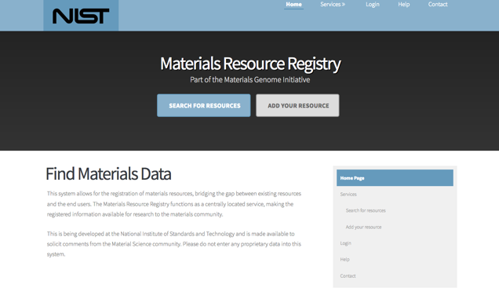
Materials Resource Registry
https://materials.registry.nist.gov/

Slide 9
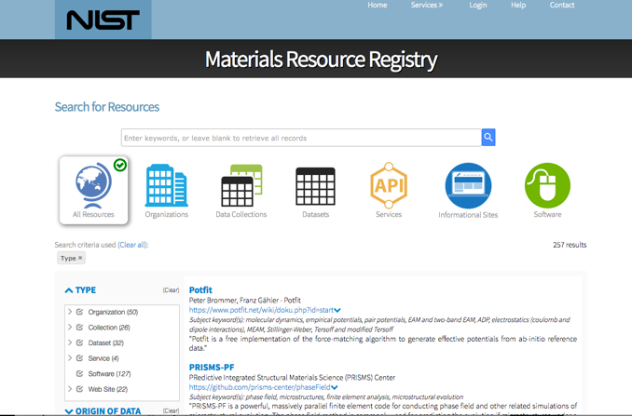
https://materials.registry.nist.gov/

Slide 10
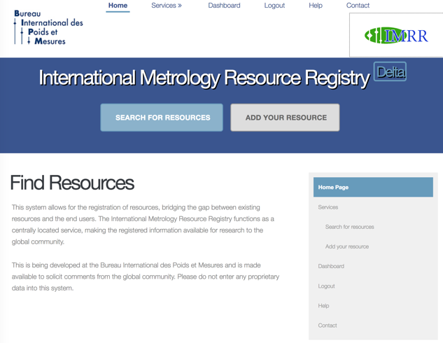
http://imrr.bipm.org/

Slide 11
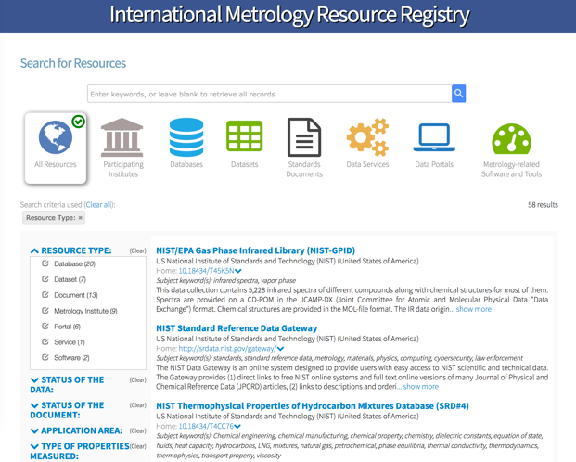

Slide 12
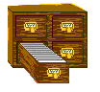


Federated Architecture
Full
Searchable
Registry
Resource
Registry
harvest
(pull)
replicate
OAI/PMH
Local
Publishing
Registry
Full
Searchable
Registry
major
data
providers
search
queries
Local
Publishing
Registry
Users,
applications

Slide 13
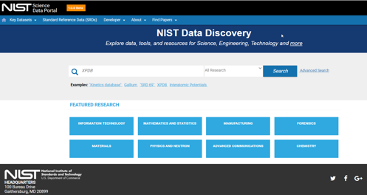
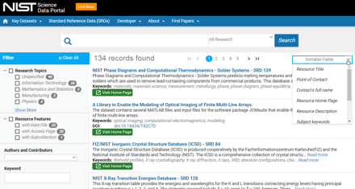
Data Discovery for Public Research Data
Search NIST public data records
View metadata
Filter results
Access data files, metadata
APIs allow interoperability with client tools
Records link to Public Data Repository

Slide 14
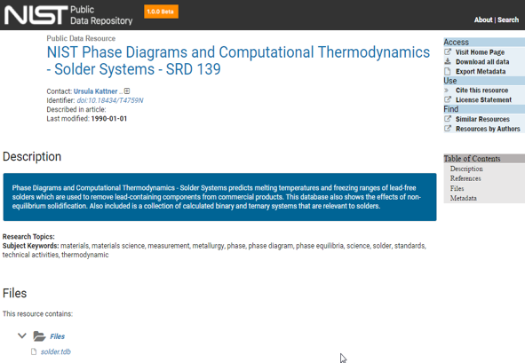
NIST Public Data Repository – Basic Landing Page

Slide 15
Access

Slide 16
NIST Public Data Access Policy
Strengthen NIST’s commitment to providing public access to scientific research results
Support governance of and best practices for managing peer-reviewed scholarly publications and digital scientific data across NIST
Ensure effective access to and reliable preservation of NIST peer-reviewed scholarly publications and digital scientific data for use in research, development, education, and scientific discovery
Increase use to NIST research results to enhance scientific discovery, education, and research and development across the US
Enhance innovation and competitiveness by maximizing the potential to create new business opportunities
There are provisions for data privacy in certain circumstances, e.g., CRADAs
http://www.nist.gov/data/upload/NIST-Plan-for-Public-Access.pdf

Slide 17
NIST Public Data Access Policy
data.gov
public
data
Standard
Reference Data
and Published Results
Publishable Results
Derived Data
storage,
sharing, and
collaboration
Working Data

Slide 18
Data Management Plans
Required for all NIST staff engaged in data-generating research
All public-facing data products must be registered in the Enterprise Data Inventory (EDI)
  Metadata schema defined by OMB
  Records periodically copied into data.gov

Slide 19

Gather Data Management Plans
MML DMPs
minerva.nist.gov
midas.nist.gov
A DMP tells us
What are the data-generating activities
What types of data are produced
How the data are managed and preserved
How they are reviewed and made available

Slide 20
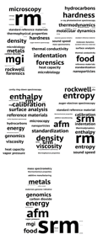
Feed a System of Metadata Catalogs
NIST Enterprise Data Inventory (EDI)
Data.gov
Dataset information:
Title
Description
Contact
Keywords
License
Access (public?)
Location of data
References/Guides
Last update
MML dataset information

Slide 21

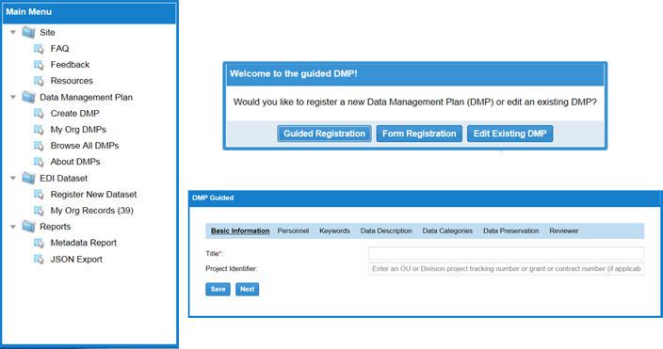

Slide 22
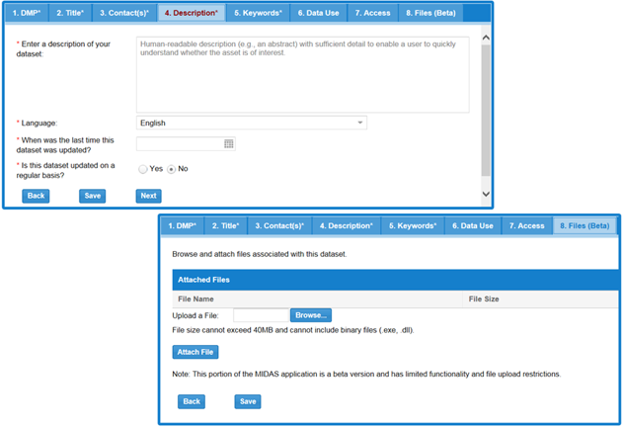
Creating an
Enterprise
Data
Inventory
Record

Slide 23
Research Data Infrastructure

Slide 24
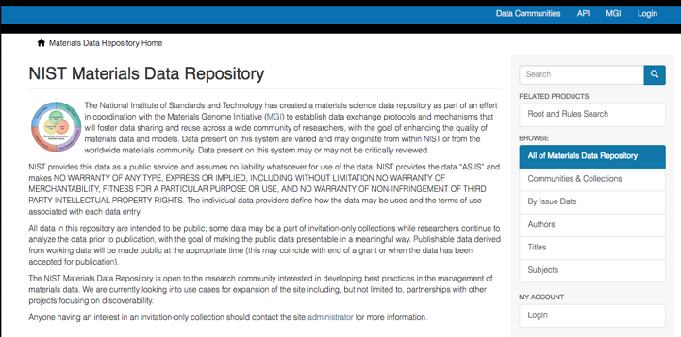
materialsdata.nist.gov

Slide 25
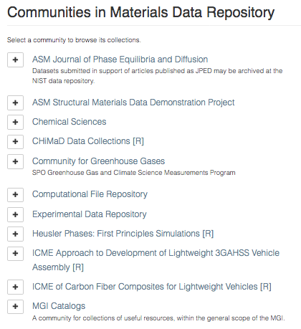
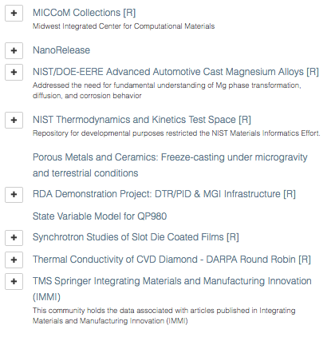

Slide 26
Standard Reference Data
SRD are an exemplar of well-characterized data
  Fitness for purpose
  Quantified uncertainties
  Acquisition methods documented
  Provenance established
  Expert review and assessment

Slide 27
Standard Reference Data
SRD evaluation criteria
Numerical data:
Assuring the integrity of the data, e.g., by provision of uncertainty determinations and use of standards;
Checking the reasonableness of the data, e.g., by consistency with physical principles and comparison of data obtained by independent methods; and
Assessing the usability of the data, e.g., by inclusion of metadata and well-documented measurement procedures
Digital data objects:
Assuring the object is based on physical principles, fundamental science, and/or widely accepted standard operating procedures for data collection; and
Checking for evidence that
  The object has been tested, and/or
  Calculated and experimental data have been quantitatively compared

Slide 28
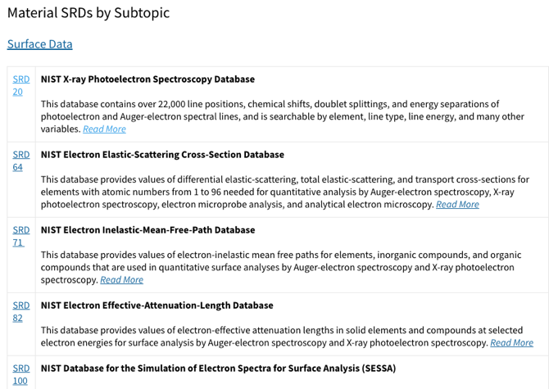
Standard Reference Data
Analytical and Chemical Data
https://www.nist.gov/srd/materials

Slide 29
Interoperability

Slide 30
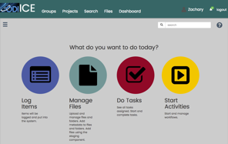
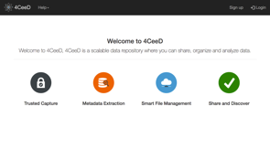
Laboratory Information Management Systems
Integrated Collaborative Environment (ICE)
  Running now at http://ice.nist.gov
  Developed by Air Force Research Laboratory
Timely and Trustworthy Curating and Coordinating Data Framework (T2C2) 4CeeD system
  Running now at http://t2c2.nist.gov:32500/
  Developed by University of Illinois at Urbana-Champaign
Metadata extraction using HyperSpy open source software, Python, Jupyter notebooks
  http://hyperspy.org

Slide 31
Laboratory Information Management Systems
Capture instrument metadata at the source
  Metadata extractors
  Often must reverse engineer proprietary binary formats
Move experiment metadata into database
  Enable search across many experiments
  Do not use filenames/file system for metadata storage
Enable scripted data processing, calibration, feature extraction
Support data management from acquisition to publication; improve reproducibility

Slide 32
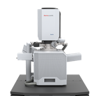
LIMS Help Manage the Data Lifecycle
Plan
Acquire
Process
Analyze
Store
Share
Reuse
Dispose
Metadata
Data
LIMS
LIMS
Read + Extract
Archive
Front-End File Management Tools
Convert
+
Export
Curation
Credit: Rachel Devers, SURF program
Notes:
Intro: A LIMS platform would be an enabling component towards better adoption of FAIR data principles
Meat:
What is LIMS
Functionality:
Designed to handle data + metadata from the point of data acquisition @ instr. wkst. and carry it thru the lifecycle using a cloud based coordination service
Ideally would provide front-end tools for facility users that enable FAIR data principles
Results In:
RE-associated MD + Data == enables data reuse
Automated data transfer through life-cycle == eliminates user grunt work
Extraction → ability to view/index data + metadata ~> data transparency == more findable, more accessible
Conversion to open-source formats → easier to share/collaborate + alignment w/industry interoperability standards
Transition:
For my project I focused on the *󠇫**’d portions of the lifecycle
Rather than creating software, MSED was interested in evaluating open source LIMS options that could work w/the existing infrastructure
While there are various O-S software options available we ultimately decided to evaluate and create a demo of the functionality of the T2C2 Data Framework because it was designed w/ material related scientific data in mind

Slide 33
Materials Data Curation System

Slide 34




Materials Data Curation System
Digital Data
& Metadata
(any format)
Web
Framework
Data Analysis Infrastructure
GUI
Exporter
REST API
Data Provider
Harvester
Simulation
User Scripts
Data Management
& Search Engine
Harvester
Data
Metadata
Images
Large Files
BLOBs
Measurement
Database
Large Dataset
Repository
Data Provider

Slide 35
Challenges with Experimental Data
Undefined Structure
SampleIdent CPD RR S
BANK 1 7251 726 CONST 500.00 2.00 0.000 0.000
1 153 1 161 1 141 1 141 1 148 1 163 1 139 1 139 1 129 1 132
1 129 1 129 1 151 1 121 1 129 1 127 1 127 1 151 1 139 1 146
1 129 1 134 1 125 1 114 1 129 1 127 1 125 1 129 1 121 1 121
Different Formats
SampleIdent CPD RR Sample 1B DataFileName CPD-1B
DiffrType PW3710 GeneratorVoltage 40 TubeCurrent 40
Anode Cu Alpha1 1.54056 Alpha2 1.54439 Ratio 0.50000
MonochromatorUsed YES DivergenceSlit 1 ReceivingSlit 0.3
5.000 0.020 150.000 MeasureDateTime 20/12/1997 17:18 StepTime 3.00
184 171 182 184 176 169 156 161 182 166
171 163 146 158 158 169 182 151 171 136
156 158 148 153 151 156 139 158 125 163
Only an expert human can understand this number.
To a computer, this is a meaningless collection of numbers
This file was converted to xda by WinFit!
5.0000 150.0000 0.0200 1.0000
177. 182. 174. 154. 177. 156. 172. 161. 146. 169.
144. 154. 161. 156. 144. 166. 164. 119. 182. 135.
164. 128. 154. 114. 142. 121. 144. 154. 137. 137.

Slide 36
Structured Data Based on Data Model
{"diffractogram": {
"xray-source": {
"tube": {"anode-material": "Cu",
"spectra": {"emission-line": [
{"Siegbahn": "Kalpha",
"wavelength": {"value": 1.54184,"unit": "angstrom"}},
{"Siegbahn": "Kalpha1",
"wavelength": {"value": 1.54056,"unit": "angstrom"}},
{"Siegbahn": "Kalpha2",
"wavelength": {"value": 1.54439,"unit": "angstrom"}}
]}}},
"pattern-data": {
"angle-2-theta": {
"value": [9.3,9.32,9.34, ... 75.16,75.18,75.2],
"unit": "degree"},
"intensity": {
"value": [681.02,687.34,703.49, ... 127.52,124.29,118.32],
"unit": "arbitrary"}}}}

Slide 37
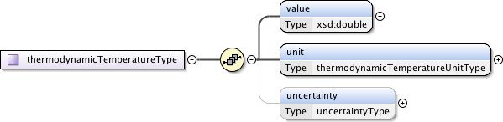
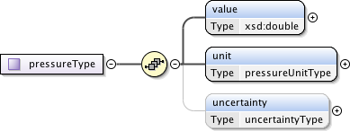

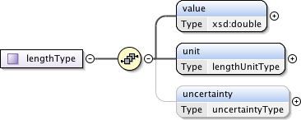
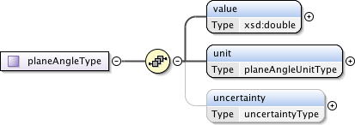
Modularity: Foundational Types

Slide 38
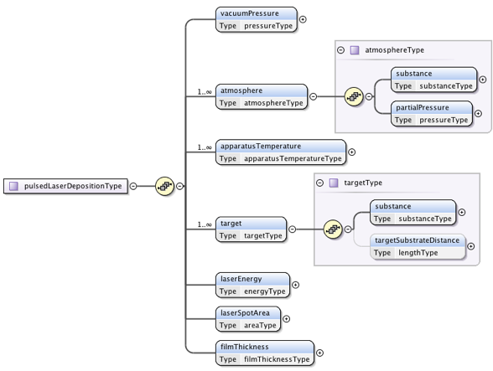

Data Models Re-Use Components
Substance Module
Physical Quantity Types

Slide 39
NIST Beamline Data Transfers - Globus
NIST scientific research use cases require secure and reliable large dataset network transfers to support further processing & analysis of data
  Argonne APS -> NIST Gaithersburg
  NIST inter-site (Boulder, BNL, …)
  BNL beamline data -> Gaithersburg
Completed Globus pilot with NIST authorization for use (FY17-18)
  DOE/NIST interagency agreement and approved connectivity to ESNET
  Demonstrated successful multi-TB test data transfers between ANL beamline facility and NIST Gaithersburg
Current effort at NIST focused on internal network connectivity (endpoint to desktop) for performance

Slide 40






Globus Secure Data Transfer Concept
BNL
Managed Endpoint
NIST Gaithersburg
Managed Endpoint
Remote User
Control
Domain
ESNET
DATA Network
Station Data
Admin Managed Filesystem Restrictions
Globus Control Domain
User Managed Permissions

Slide 41
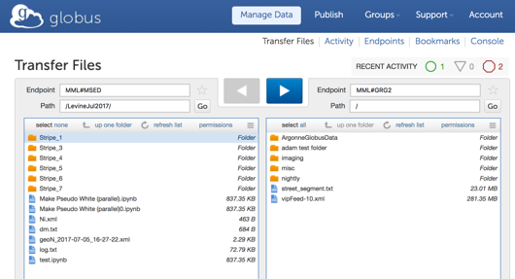
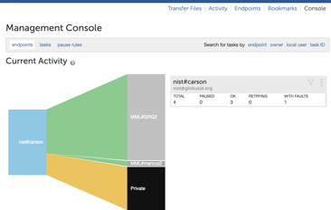
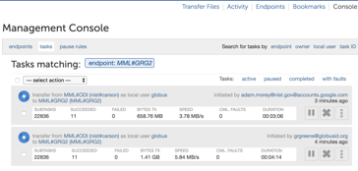
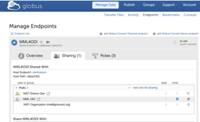
Globus Management Console
File Transfer initiation and activity monitoring – transfer rates, bytes
User Group Management and Roles
GUI Console actions can also be managed with CLI

Slide 42
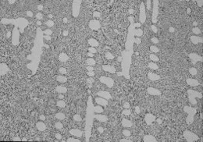
Metadata for Microstructures
Image annotation: who, what, when, where, why?
Structure annotation: characterization parameters, grain size distribution, …
Workshops this fall and next spring organized with Lehigh University (J. Rickman)

Slide 43
Microstructure Characterization

Slide 44
Artificial Intelligence / Machine Learning
Want to find patterns in data.
  Derived rules with list of exceptions.
AI lets us algorithmically extract patterns / relationships from large and complex data
Complex rules and exceptions
Machine Learning
  The computer “learns” the rules and exceptions.
  Training Data
  Learning Framework aka Machine Learning Algorithm

Slide 45
Data Management for AI/ML
Aggregation of metadata in a searchable database to facilitate search and discovery
Mapping of metadata and data into non-proprietary and widely used formats
Preservation of metadata and data in a durable repository
Documentation of data (data dictionaries, common metadata schemas, identification of units with standard notation)

Slide 46

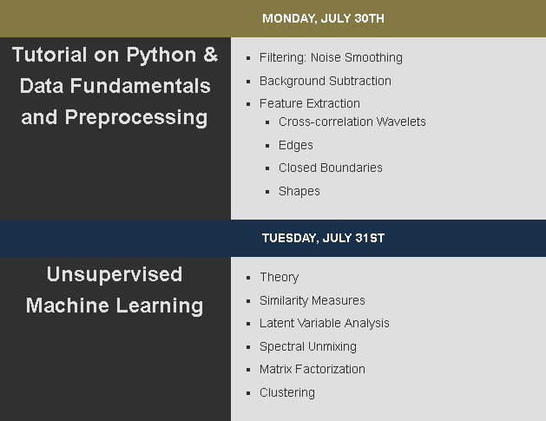
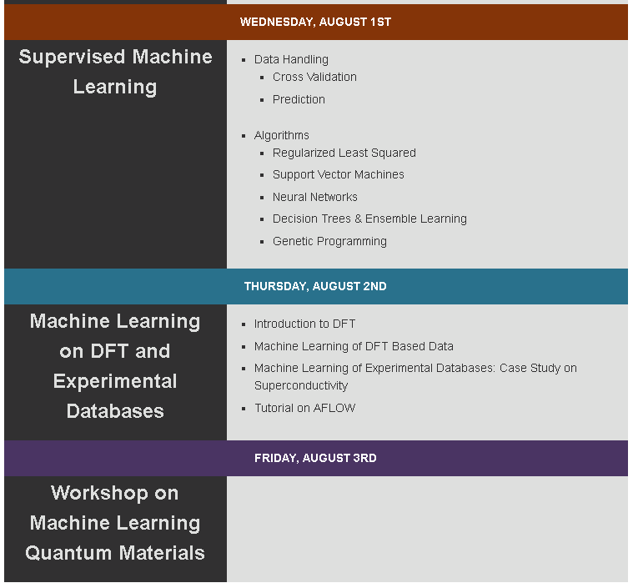




Bootcamp and Workshop 2018
https://nanocenter.umd.edu/events/mlmr/

Slide 47
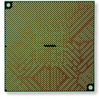
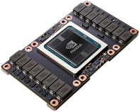
AI/ML Hardware
$2M approved for purchase of compute cluster tailored to AI/ML
  13 nodes
    2 x 20 core 2.0 GHz CPUs
    4 x V100 “Volta” GPUs, 5120 cores and 16GB RAM each
    1 TB RAM
    3.8 TB solid-state disk storage per node
    High-speed (100GbE) Infiniband networking (internal)
  High-speed (10GbE) networking (external)
  ≈ 300 TB disk storage array
Each V100 chip delivers 125 TFLOPS of machine learning performance
Very fast internal bandwidth optimized for processing large volumes of data
More than an order of magnitude speed up over traditional architectures

Slide 48
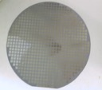
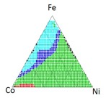
Phase Mapping: High-Throughput Approach
Fabricate hundreds-thousands of samples -> high-throughput synthesis
Measure all samples -> high-throughput characterization
Rapid phase mapping -> machine Learning
Fe
Co
Ni
Combi Library for Ternary Spread
Estimated Phase Map
APL Materials (2016) Composition–structure–property mapping in high-throughput experiments: Turning data into knowledge
Fe
Diffraction Patterns
Machine Learning
XRD
Co
Ni
Notes:
More recently we’ve worked on high throughput techniques for phase mapping using high throughput synthesis and characterization.
Synthesis is performed using combinatorial library techniques, allowing us to create hundreds of samples that cover a composition diagram.
In this case we’ve made a composition spread of Fe Co and Ni and measured each sample’s composition giving us the points in this composition diagram.
We can then use high throughput diffraction systems to measure all the points for their structure.
The composition and structure data is then fed into a machine learning package to identify the phase map. This machine learning part takes minutes.

Slide 49
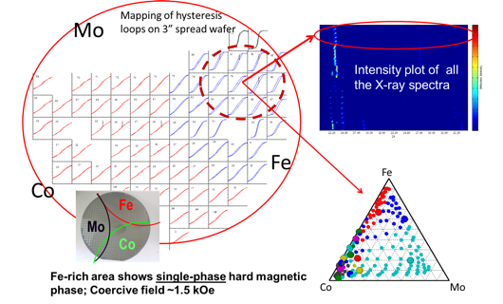
On-the-Fly Machine Learning
Search for rare-earth free permanent magnets
Kusne, et al. Scientific Reports 4, 6367 (2014)
Notes:
One of these methods was used during data collection at SLAC in a search for rare-earth free permanent magnets. As the data was being collected, the experimentalist was able to see the phase diagram being generated sample by sample. The experimentalist was able to quickly identify this phase boundary region as one of interest and from more investigation was able to identify a new rare-earth free permanent magnet.
We applied this on the fly code to analyze data being collected from the Mo-Co-Fe system and the experimentalist was able to immediately see a phase map for the wafer. He then investigated the phase change boundaries here and here and was able to discover a new rare-earth-free permanent magnet.

Slide 50
Summary
Comprehensive data management strategy is important for
  Data sharing, re-use, interoperability
  Transfer of data through space and time (graduate students, postdocs)
  Maximizing return on research investment (e.g., HST archive, SDSS)
  Supporting AI/ML applications
Cost is manageable, 1-10% of overall facility operations budget

Slide 51

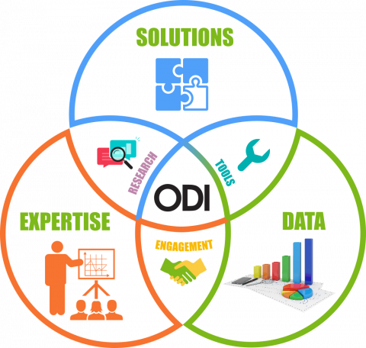
https://www.nist.gov/mml/odi

