Slide 1
UW-Madison Shared Instrumentation Facilities SQL Server Reporting Services (SSRS) Facilities Online Manager (FOM) Reporting Tool Jerry Hunter, Director Wisconsin Center for Applied Microelectronics (WCAM) Materials Science Center (MSC) Soft Materials Laboratory (SML)

Slide 2
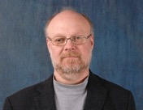
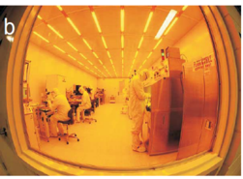
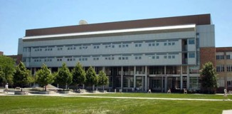
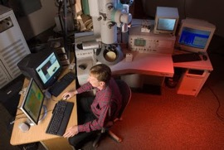
CoE Core Facilities Overview
Director: Jerry Hunter
Wisconsin Center for Applied Microelectronics
Micro and nano-fabrication facility
10,000 sq. ft. cleanroom with 60 instruments
Soft Materials Lab
Polymer characterization laboratory
30 major instruments
Materials Science Center
High end microscopy and microanalysis facility
30 major instruments

Slide 3
Overview: FY17 Use
Usage statistics (FY17)
Research in the Physical Sciences
Materials structure/property relationships
Structures, magnetism and electronics
Advanced materials for energy
Flexible electronics
Quantum devices
Power electronics
Organic/Inorganic interfaces
Research in the Biological Sciences
Hierarchical and active soft materials
Molecular virology
Plant pathology
Membrane trafficking pathways in plants
~77,000 use hours from 45,000 activities
180 Principle Investigators and ~700 users
48 different departments covering 8 colleges/schools
~30 Companies
~10 other institutions
8 courses supported
320 grants totaling $175M in research supported

Slide 4
Data gathered by FOM
User information (contact info, PI, permissions, funding, department, college)
Instrument information (description, down time and maintenance duration and descriptions, operating procedures, usage, facility/center, etc.)
Usage information (who, when, instrument, charge, duration, reservations)

Slide 5
What is required?
Does not need to be FOM. UW-Madison has used FOM and a separate standalone database.
Database needs to be Structured Query Language (SQL)
You need administrator access to the database
Need someone to install and configure SQL Server Reporting Services (SSRS)
Need someone that knows how to setup permissions on Windows serve`r
If you want to write your own queries you need to understand your database structure and how to write queries (MS Access)
If you are interested contact jerry.hunter@wisc.edu

