Slide 1
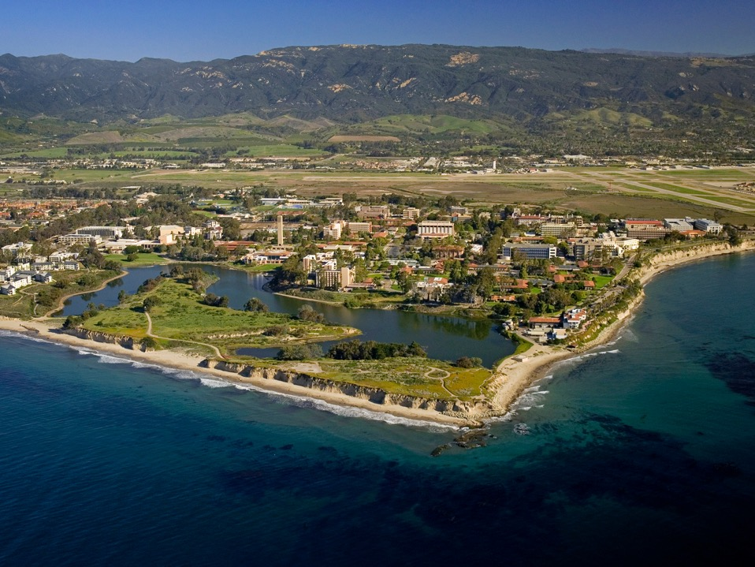
Data in the Context of Shared Facilities
Ram Seshadri
Fred and Linda R. Wudl Professor of Materials Science
Materials Department and Department of Chemistry & Biochemistry
Director, Materials Research Laboratory: An NSF MRSEC
University of California
Santa Barbara CA 93117 USA
seshadri@mrl.ucsb.edu
NSF Shared Facilities Operations Workshop at UC Santa Barbara,
March 2018
Photo by Tony Mastres

Slide 2
The Data Management Plan
News Release 10-077
Government-wide emphasis on community access to data supports substantive push toward more open sharing of research data
May 10, 2010
… NSF is planning to require that all proposals include a data management plan in the form of a two-page supplementary document.
… "Digital data are both the products of research and the foundation for new scientific insights and discoveries that drive innovation."
"Twenty-first century scientific inquiry will depend in large part on data exploration," said José Muñoz, acting director of the Office of Cyberinfrastructure. "It is imperative that data be made not only as widely available as possible but also accessible to the broad scientific communities."
Seidel noted that requiring the data management plans was consistent with NSF's mission and with the growing interest from U.S. policymakers in making sure that any data obtained with federal funds be accessible to the general public.

Slide 3
The Data Management Plan, questions
The responsibilities for data curation and archiving are clearly PI-centric.
What about larger grants like the MRSE. What is the role of the facility?

Slide 4
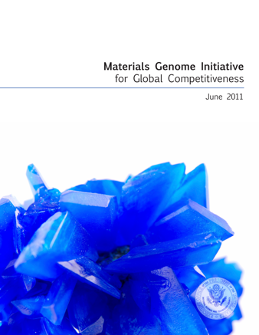
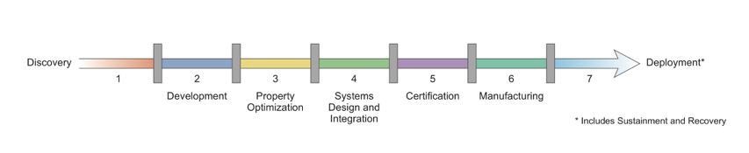
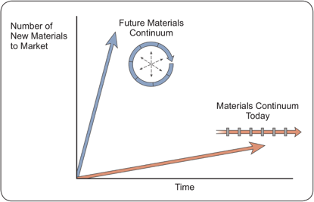
The Materials Genome Initiative
The Materials Genome Initiative is a multi-agency initiative … to discover, manufacture, and deploy advanced materials twice as fast, at a fraction of the cost.
“Advanced materials are essential to economic security and human well being, with applications in industries aimed at addressing challenges in clean energy, national security, and human welfare, yet it can take 20 or more years to move a material after initial discovery to the market. Accelerating the pace of discovery and deployment of advanced material systems will therefore be crucial to achieving global competitiveness in the 21st century.”
“Data transparency may have the largest impact after the material has been deployed, due to the fact that every industry relies on materials as components of product design …Data transparency encourages cross-industry and multidisciplinary applications.”

Slide 5
Data
Are we storing it securely?
Is it being properly curated?
What doe we need in order to do this?
Are the many efforts across funding agencies (and professional societies) somewhat disconnected?

Slide 6
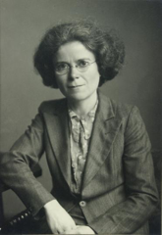
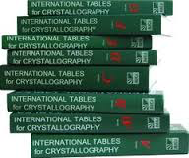
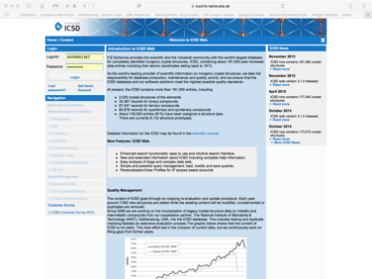
A digression into crystallographic databases: The importance of curation
Uniform schema for crystal structures
Kathleen Lonsdale, DBE, FRS [1903–1971]
.cif files
the ICSD

Slide 7
A digression into crystallographic databases
Materials Project
AFLOW
OQMD
the ICSD

Slide 8
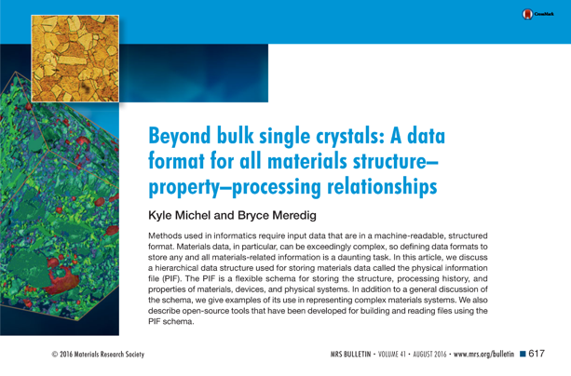
The message: We need a .mif, and the appropriate encouragement to use it
The Materials Information File
The Physical Information File
Should we do DOIs for data?

Slide 9
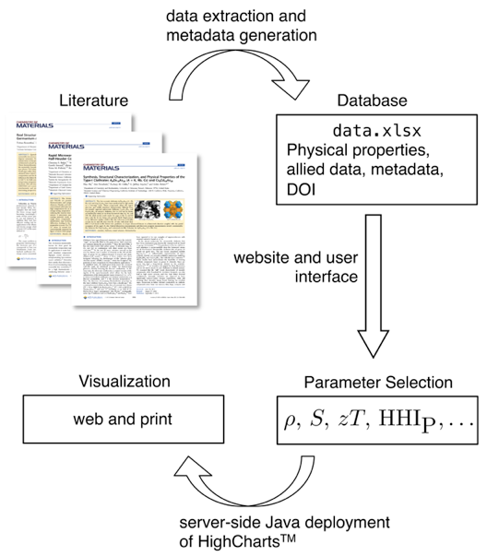
Data-mining approaches to new thermoelectric materials
It is of little use to gather a lot of data if we only use conventional visualization strategies (eg. plots on sheets of paper)
We have developed a web-based visualization tool.
The only input is an appropriately formatted Excel file.
tiny.cc/datamine

Slide 10
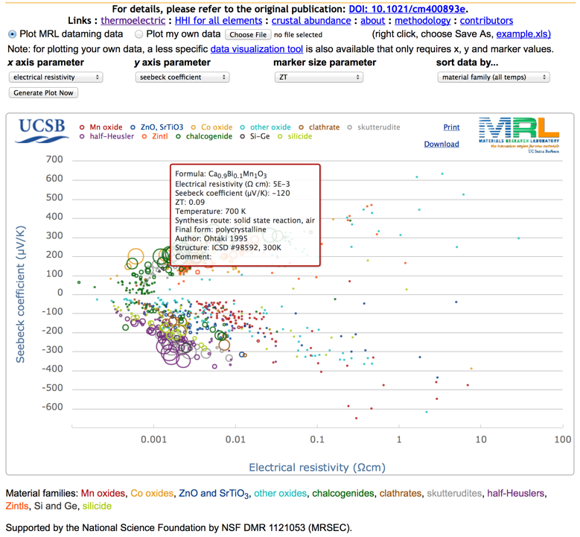
Screenshot
tiny.cc/datamine

Slide 11
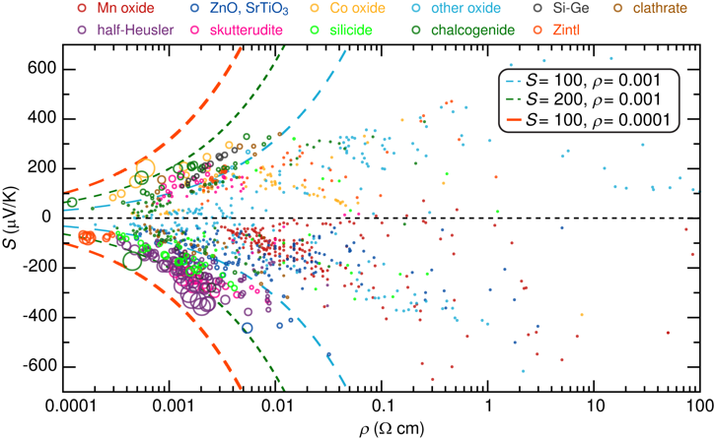
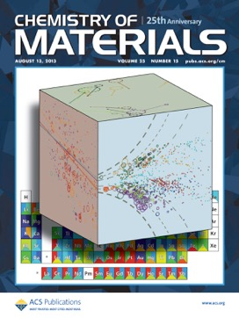
Data-mining approaches to search for new thermoelectric materials
We construct such plots of the Seebeck coeff. vs. electrical resistivity (here measured at 700 K) using data from the literature: Over 100 publications, from which 18 000 data points were extracted. The size of each point is the power factor
Gaultois, Sparks, Borg, Seshadri, Bonificio, Clarke, Chem. Mater. 25 (2013) 2911–2920.
Where not to look in parameter space ! “You can see a lot by just looking.” – Yogi Berra

Slide 12
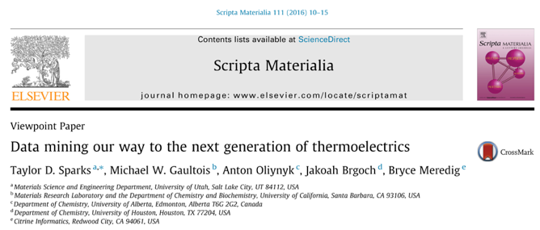
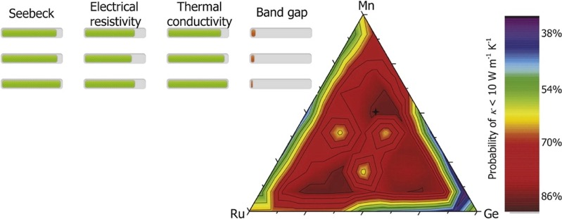
Can we machine-learn from the data?

Slide 13
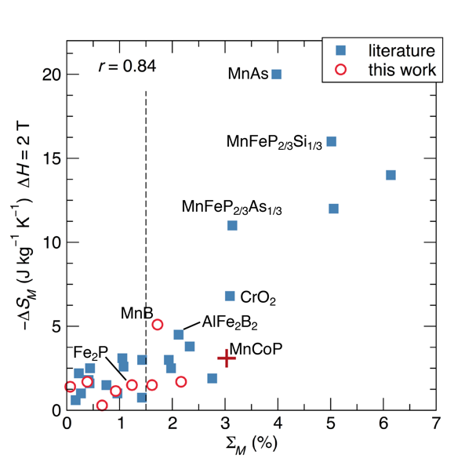
The need for all data; not just data associated with high-performing materials
Creating a computational proxy for screening magnetocaloric materials requires both underperforming materials as well as high-performing materials to be studied.
Bocarsly, Levin, Garcia, Schwennicke, Wilson, Seshadri, A simple computational proxy for screening magnetocaloric compounds, Chem. Mater. 29 (2017) 1613–1622.

Slide 14
Databases created
Thermoelectrics datamining and visualization:
http://www.mrl.ucsb.edu:8080/datamine/thermoelectric.jsp
Wide band-gap semiconductor datamining and visualization:
http://www.mrl.ucsb.edu:8080/datamining/wbgsemiconductor.jsp
Battery datamining (hosted by the Sparks group at Utah):
http://tomcat.eng.utah.edu/sparks/battery.jsp
Phosphor datamining:
http://www.mrl.ucsb.edu:8080/pdatamine/phosphor.jsp
Generic datamining and visualization:
http://www.mrl.ucsb.edu:8080/data/visualization.jsp
Ferromagnets (for magnetocalorics):
http://magnets.mrl.ucsb.edu

Slide 15
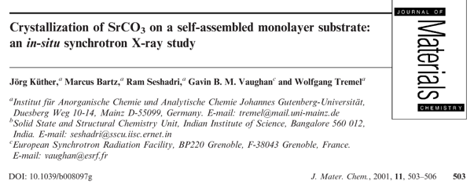
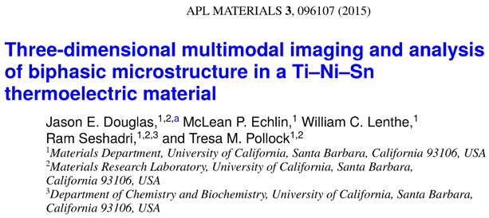
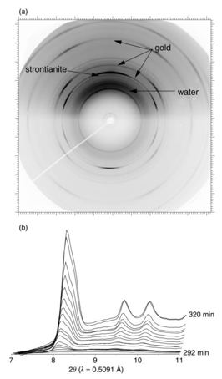
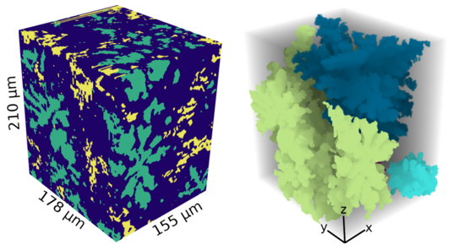
The issue of volume
Close to 20 GB of data taken over 3 days (lots of data discarded)
Close to 1 TB of data taken over a ½ day

Slide 16
Thanks !
Photo by Tony Mastres

